Slide 1
:- Asst. Prof. Sachin P Patil
Chemistry Department
S T Co-Op Education Society’s, Science Senior College, Shahada.
Electrolytic conductance

Slide 2
Session Objectives
Conductance of electrolytic solution
Specific conductance, Equivalent conductance, Molar conductance
Kohlrausch's law

Slide 3
Electrolytes
Substances whose solution in water conducts electric current.
Conduction takes place by the movement of ions.
Examples are salts, acids and bases.
Substances whose aqueous solution does not conduct
electricity are called non electrolytes.
Examples are solutions of cane sugar, glucose, urea etc.

Slide 4
Types of Electrolytes
Strong electrolyte are highly ionized in the solution.
Examples are HCl, H₂SO₄, NaOH, KOH etc
Weak electrolytes are only feebly ionized in the solution.
Examples are H₂CO_{3,} CH₃COOH, NH₄OH etc

Slide 5
Difference between electronic & electrolytic conductors
Electronic conductors
Electrolytic conductors
(1) Flow of electricity take place without the decomposition of substance.
(1)Flow of electricity takes place by the decomposition of the substance.
(2) Conduction is due to the flow of electron
(2) Flow of electricity is due to the movement of ions
(3) Conduction decreases with increase in temperature
(3) Conduction increases with increase in temperature

Slide 6
Resistance
Resistance refers to the opposition
to the flow of current.
For a conductor of uniform cross section(a)
and length(l); Resistance R,
a
Where is called resistivity or
specific resistance.
l

Slide 7
Conductance
The reciprocal of the resistance is
called conductance. It is denoted by C.
C=1/R
Conductors allows electric current to pass through them. Examples are metals, aqueous solution of
acids, bases and salts etc.
Unit of conductance is ohm⁻¹ or mho or Siemen(S)
Insulators do not allow the electric current to pass through them.
Examples are pure water, urea, sugar etc.

Slide 8
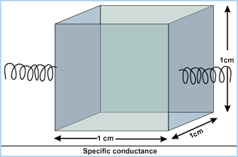
Specific Conductivity
Specific conductance
Conductance of unit volume of
cell is specific conductance.
x Conductance
l/a is known as cell constant
Unit of specific conductance is ohm^{–1}cm^{–1}
SI Unit of specific conductance is Sm^{–1} where S is Siemen

Slide 9
Equivalent Conductance
It is the conductance of one gram equivalent of the electrolyte dissolved in V cc of the solution.
Equivalent conductance is represented by
Mathematically,
Where, k = Specific conductivity
V = Volume of solution in cc. containing one gram equivalent of the electrolyte.

Slide 10
Molar conductance
It is the conductance of a solution containing 1 mole of the electrolyte in V cc of solution. it is represented as μ.
=k x 1000/M
Where V = volume solution in cc
μ = Molar conductance
k = Specific conductance
M=molarity of the solution.

Slide 11
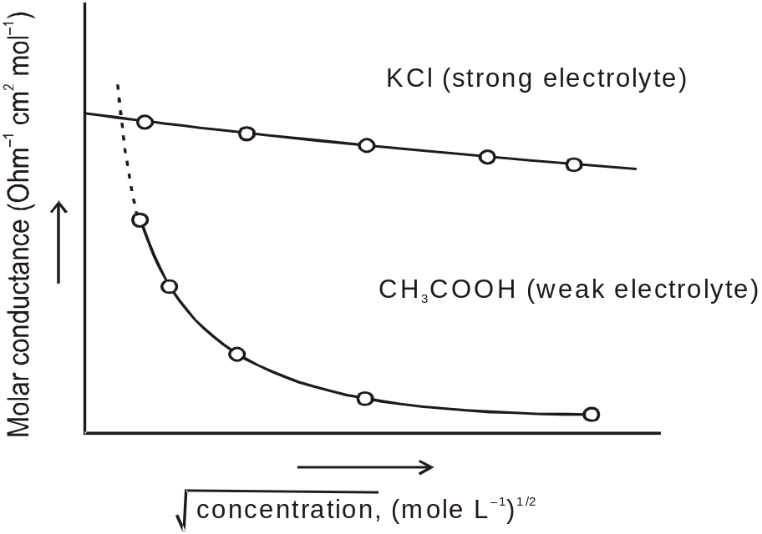
Effect of Dilution on Conductivity
Specific conductivity decreases on dilution.
Equivalent and molar conductance both increase with dilution and reaches a maximum value.
The conductance of all electrolytes increases with temperature.

Slide 12
Relation between equivalent conductivity and molar conductivity
i.e.
Molar conductivity = n- factor x equivalent conductivity

Slide 13
Illustrative Example
The resistance of 0.01N NaCl solution at 25⁰C is 200 ohm. Cell constant of conductivity cell is unity. Calculate the equivalent conductance and molar conductance of the solution.
Solution:
Conductance of the cell=1/resistance
=1/200
=0.005 S.
Specific conductance=conductance x cell constant
=0.005 x 1
=0.005 S cm⁻¹

Slide 14
Solution Cont.
Equivalent Conductance = Specific conductance x (1000/N)
= 0.005 x 1000/0.01
= 500 ohm⁻¹cm²eq⁻¹
Molar Conductivity = Equivalent conductivity x n-factor
= 500 x 1
= 500 ohm⁻¹mol⁻¹cm²

Slide 15
Kohlrausch’s Law
“Limiting molar conductivity of an electrolyte can be
represented as the sum of the individual contributions of
the anion and cation of the electrolyte.”
Where are known as ionic conductance of anion and cation at infinite dilution respectively.

Slide 16
Application of Kohlrausch’s law
(1). It is used for determination of degree of
dissociation of a weak electrolyte.
Where,
represents equivalent conductivity at infinite dilution.
represents equivalent conductivity at dilution v.
(2). For obtaining the equivalent conductivities of weak electrolytes at infinite dilution.

Slide 17
Illustrative Example
A decinormal solution of NaCl has specific conductivity equal to 0.0092.If ionic conductance of Na⁺ and Cl– ions are 43.0 and 65.0 ohm^{–1} respectively. Calculate the degree of dissociation of NaCl solution.
Solution:
Normality=0.10 N
Equivalent conductance of NaCl

Slide 18
Illustrative Example
Equivalent conductance of NaCl, HCl
and C₂H₅COONa at infinite dilution are
126.45, 426.16 and 91 ohm^{–1} cm²
respectively.Calculate the equivalent conductance
of C₂H₅COOH.
Solution:
= 91 + 426.16 – 126.45
= 390.71 ohm^{–1} cm²

Slide 19

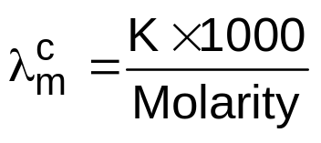
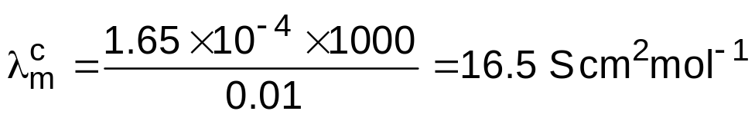
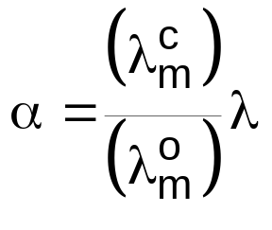
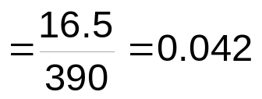
Illustrative Example
Calculate (a) the degree of dissociation and (b) the dissociation constant of 0.01M CH₃COOH solution; given the conductance of CH₃COOH is 1.65 ×10^{–4} S cm^{–1} and (CH₃COOH) = 390.6 S cm² mol^{–1}
Solution :

Slide 20
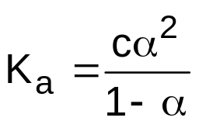
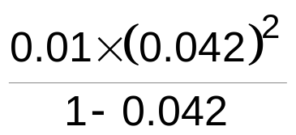
Solution
= 1.84 ×10^{–5}

Slide 21
Thank you

