Slide 1
Periodic Properties of the Elements
:- Asst. Prof. Sachin P Patil
Chemistry Department
S T Co-Op Education Society’s, Science Senior College, Shahada.

Slide 2
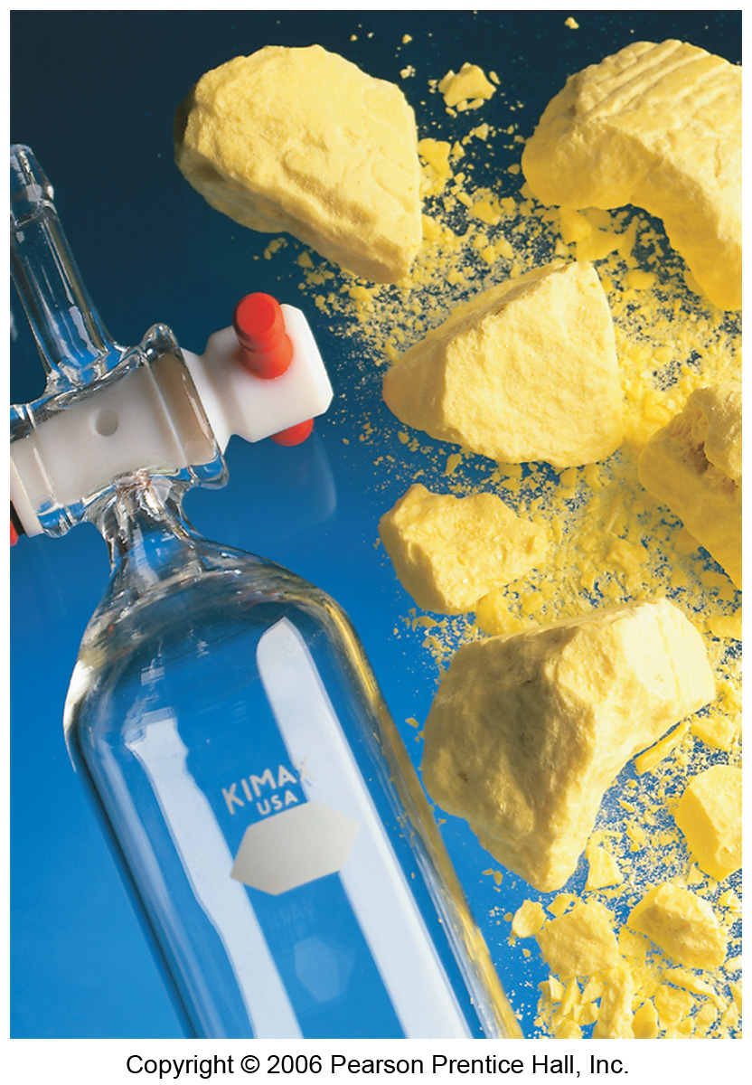
Development of Periodic Table
Elements in the same group generally have similar chemical properties.

Slide 3
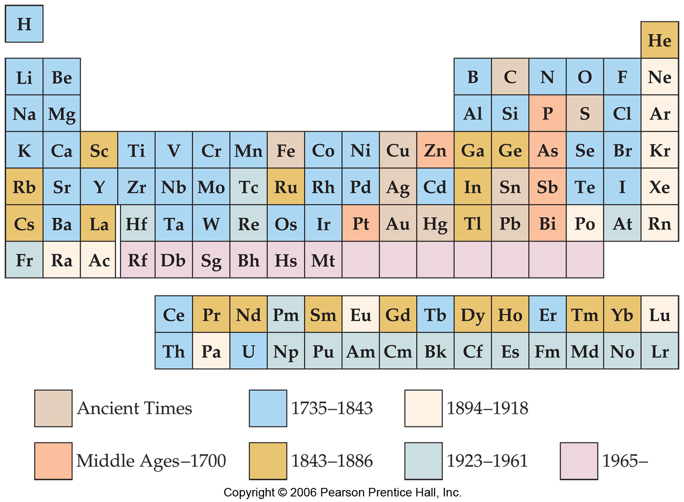
Development of Periodic Table
Dmitri Mendeleev and Lothar Meyer independently came to the same conclusion about how elements should be grouped.

Slide 4
Development of Periodic Table
Mendeleev, for instance, in 1871 predicted germanium (which he called eka-silicon) to have an atomic weight between that of zinc and arsenic, but with chemical properties similar to those of silicon.

Slide 5
Periodic Trends
In this chapter we’ll explain why
We’ll then rationalize observed trends in
  Sizes of atoms and ions.
  Ionization energy.
  Electron affinity.

Slide 6
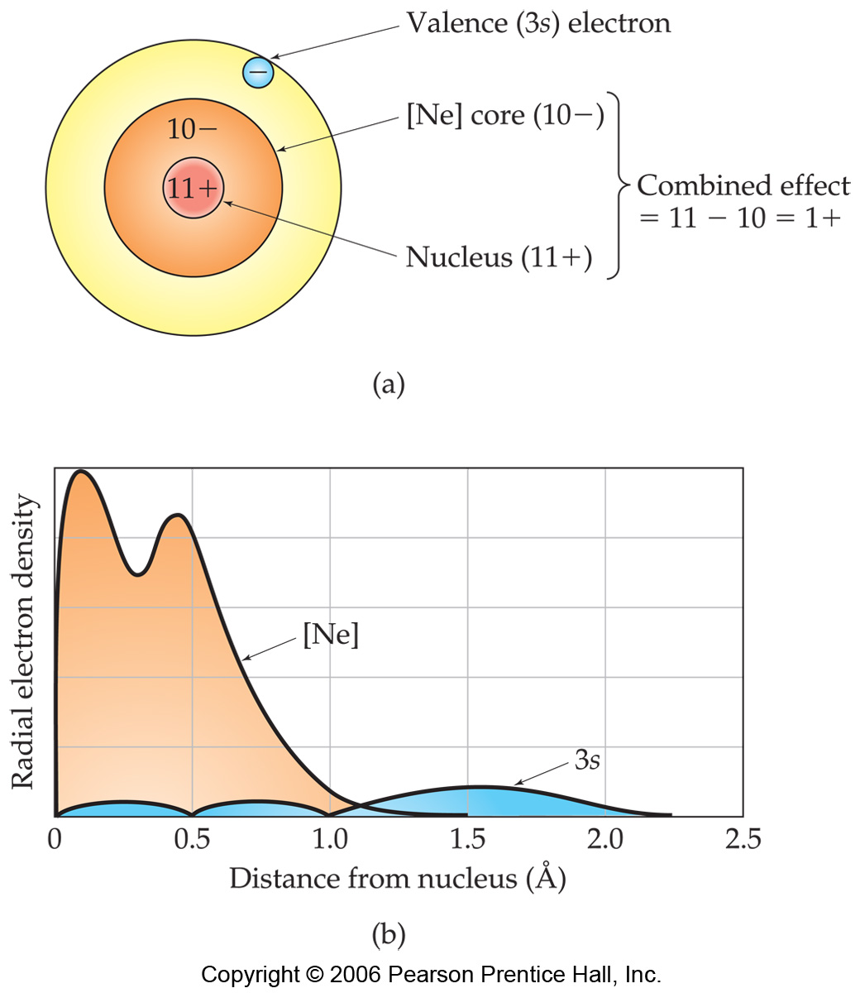
Effective Nuclear Charge
In a many-electron atom, electrons are both attracted to the nucleus and repelled by other electrons.
The nuclear charge that an electron “feels” depends on both factors.
It’s called Effective nuclear charge.
electrons in lower energy levels “shield” outer electrons from positive charge of nucleus.
Na atom looks like this:

Slide 7
Effective Nuclear Charge
Na
The effective nuclear charge, Z_{eff}, is:
Z_{eff} = Z − S
Where:
Z = atomic number
S = screening constant, usually close to the number of inner (n-1) electrons.

Slide 8
Effective Nuclear Charge
Example: Which element’s outer shell or “valence” electrons is predicted to have the largest Effective nuclear charge? Kr, Cl or O?

Slide 9
Effective Nuclear Charge
Example: Which element’s outer shell or “valence” electrons is predicted to have the largest Effective nuclear charge? Kr, Cl or O?
Cl: Z_{eff} ≈ 17 - 10 = 7
O: Z_{eff} ≈ 8 - 2 = 6
N: Z_{eff} ≈ 7 - 2 = 5
Ca: Z_{eff} ≈ 20 - 18 = 2

Slide 10
Valence electrons
Many chemical properties depend on the valence electrons.
Valence electrons: The outer electrons, that are involved in bonding and most other chemical changes of elements.
Rules for defining valence electrons.
In outer most energy level (or levels)
For main group (representative) elements (elements in s world or p world) electrons in filled d or f shells are not valence electrons
For transition metals, electrons in full f shells are not valence electrons.

Slide 11
Valence electrons
Many chemical properties depend on the valence electrons.
Valence electrons: The outer electrons, that are involved in bonding and most other chemical changes of elements.
Rules for defining valence electrons.
In outer most energy level (or levels)
For main group (representative) elements (elements in s world or p world) electrons in filled d or f shells are not valence electrons
For transition metals, electrons in full f shells are not valence electrons.
Examples: (valence electrons in blue)
P: [Ne]3s²3p³
As: [Ar] 4s²3d¹⁰4p3
I: [Kr]5s²4d¹⁰5p⁵
Ta: [Kr]6s²4f¹⁴5d³
Zn: [Ar]4s²3d¹⁰

Slide 12
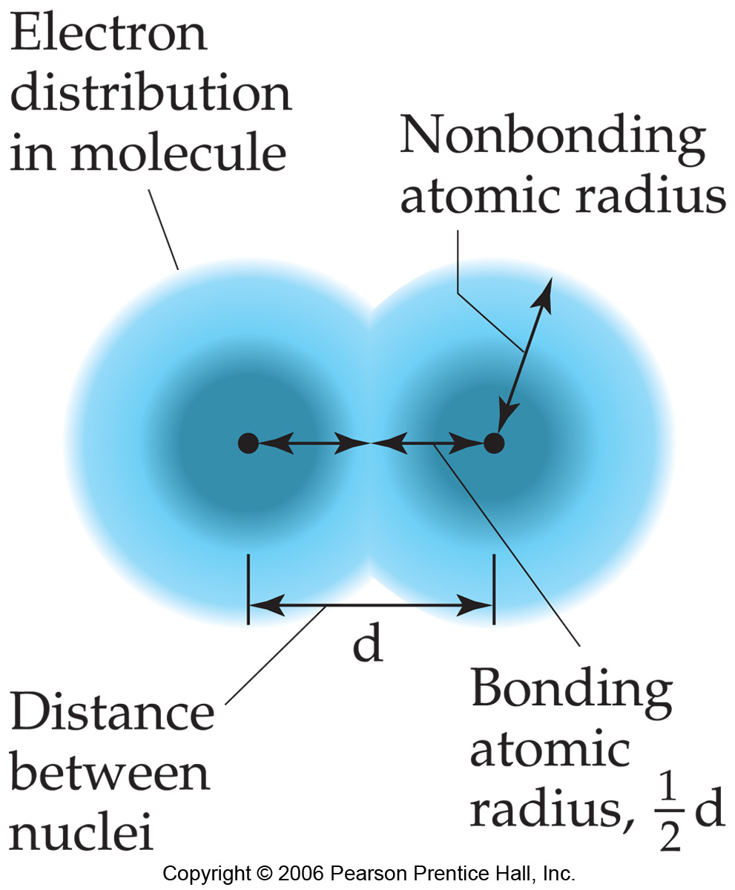
Sizes of Atoms
The bonding atomic radius is defined as one-half of the distance between covalently bonded nuclei.

Slide 13
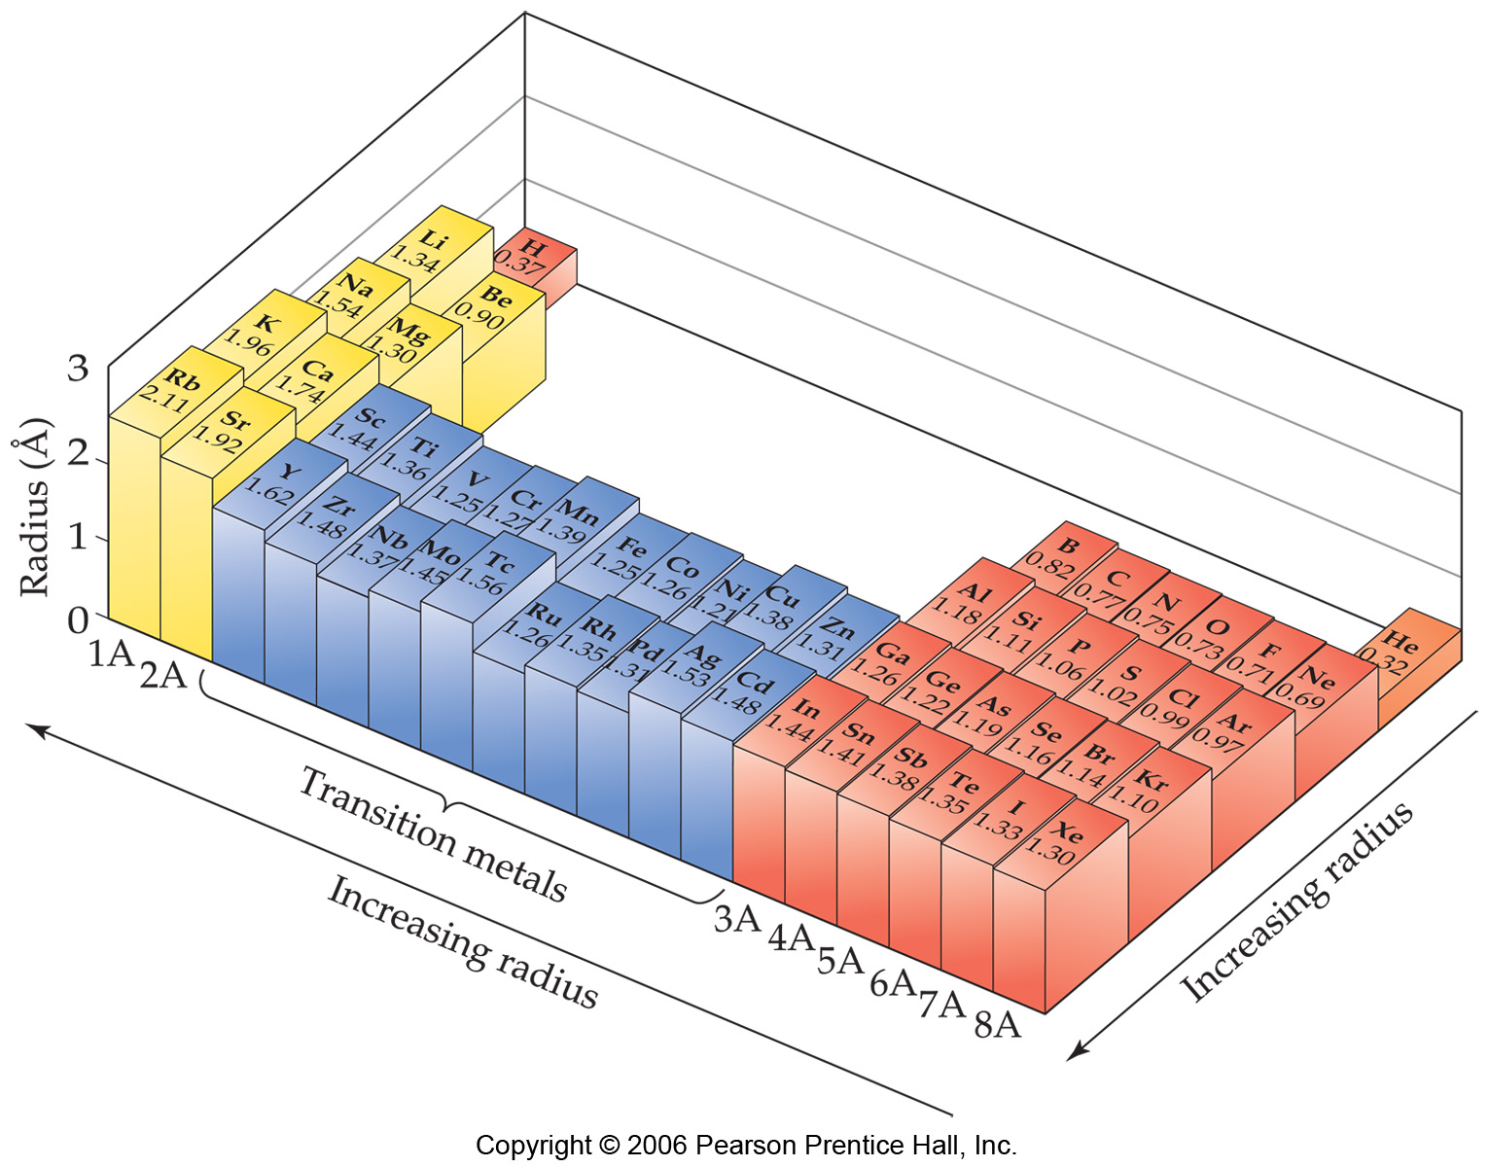
Sizes of Atoms
increasing E_{ff}
increasing n
Bonding atomic radius tends to…
  …decrease from left to right across a row due to increasing Z_{eff}.
  …increase from top to bottom of a column due to increasing value of n

Slide 14
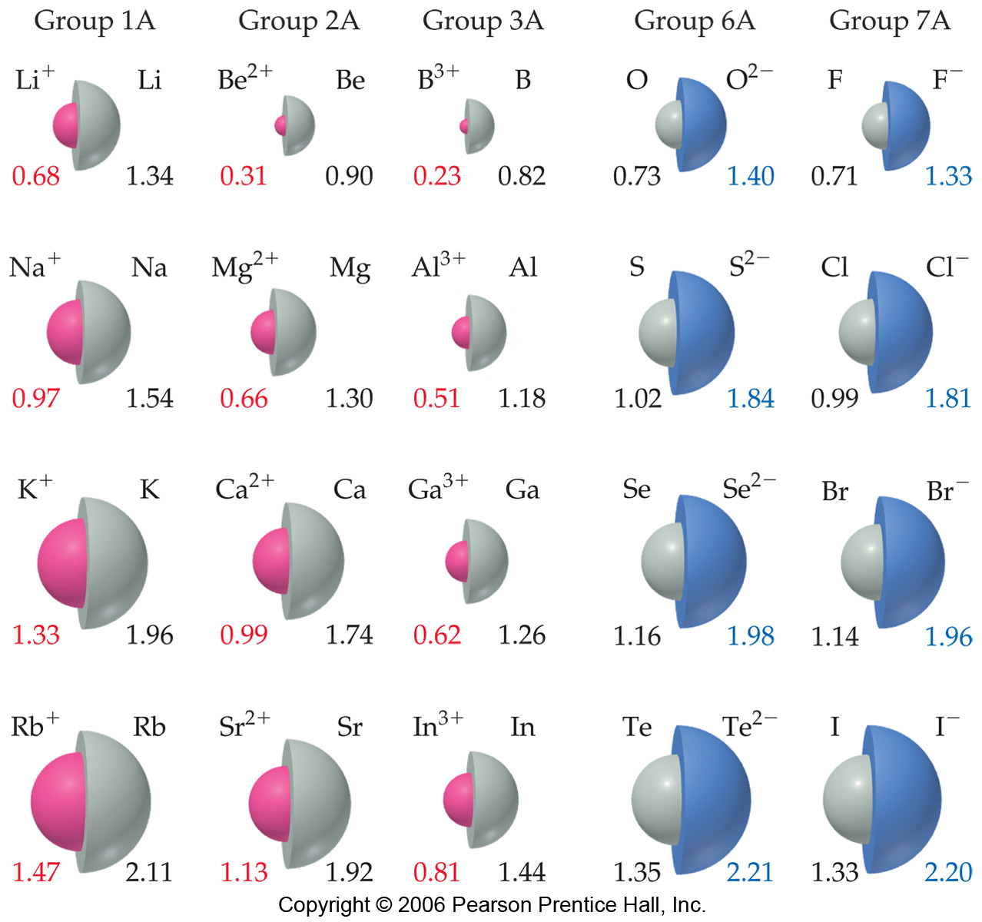
Sizes of Ions
Ionic size depends upon:
  Nuclear charge.
  Number of electrons.
  Orbitals in which electrons reside.

Slide 15
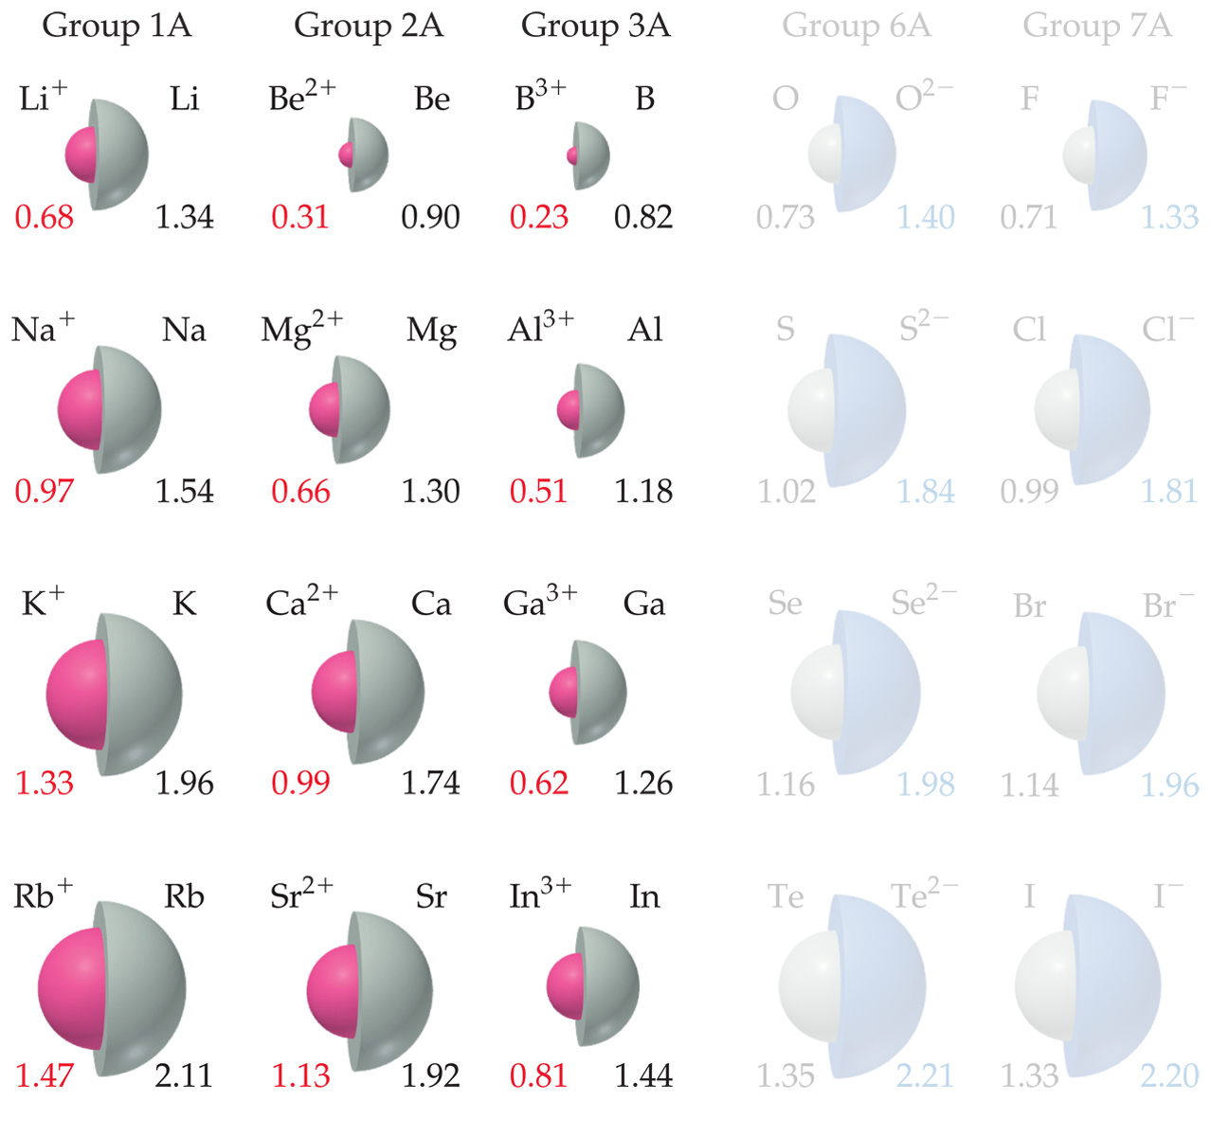
Sizes of Ions
Cations are smaller than their parent atoms.
  The outermost electron is removed and repulsions are reduced.

Slide 16
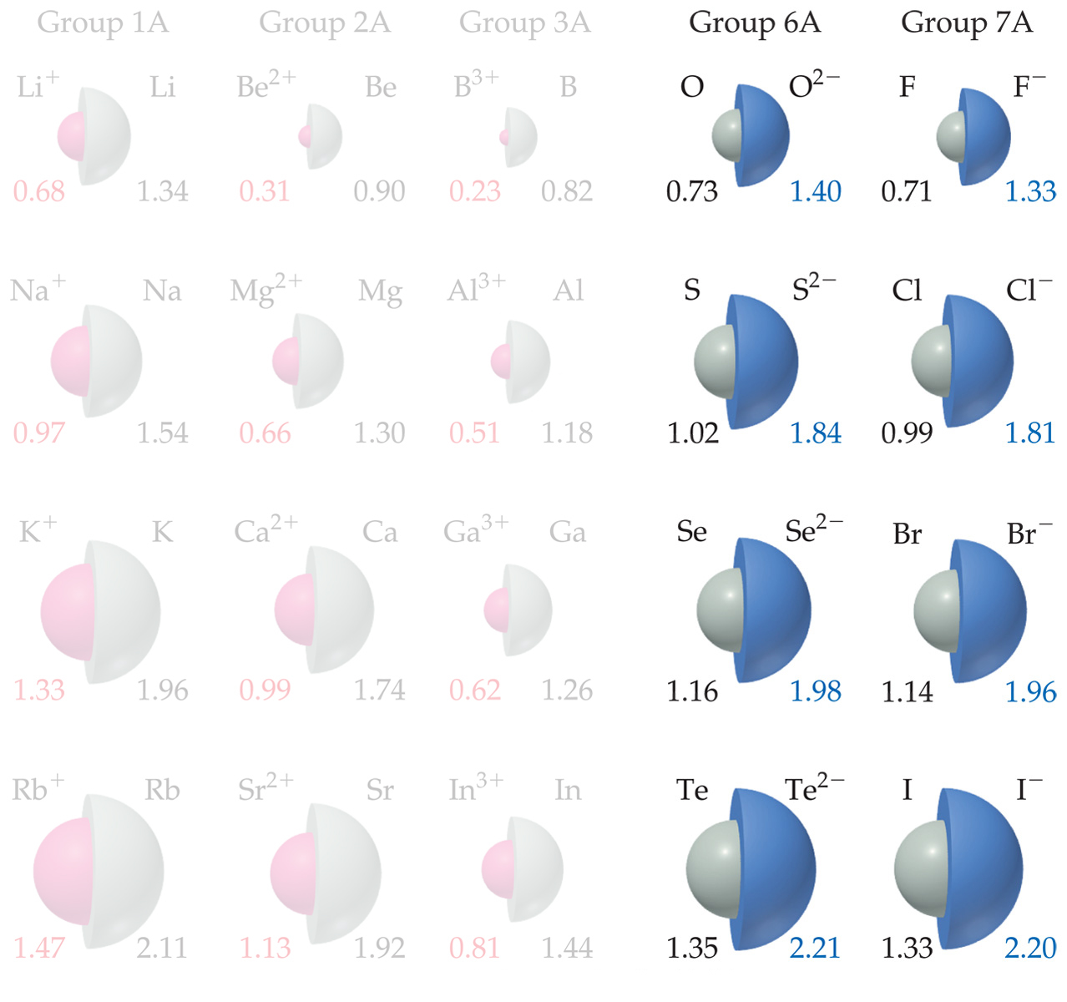
Sizes of Ions
Anions are larger than their parent atoms.
  Electrons are added and repulsions are increased.

Slide 17
Sizes of Ions
Ions increase in size as you go down a column.
  Due to increasing value of n.

Slide 18
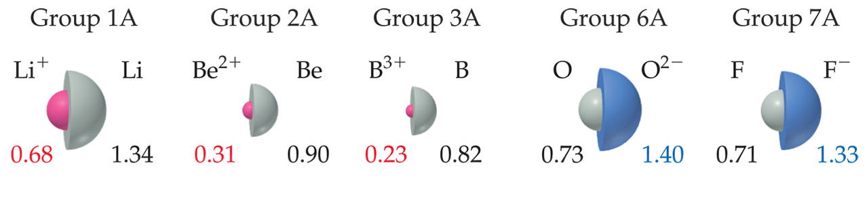
Sizes of Ions
In an isoelectronic series, ions have the same number of electrons.
Ionic size decreases with an increasing nuclear charge.

Slide 19
Ionization Energy
Amount of energy required to remove an electron from the ground state of a gaseous atom or ion.
  First ionization energy is that energy required to remove first electron.
  Second ionization energy is that energy required to remove second electron, etc.
El -------> El⁺ + e⁻
Na -------> Na⁺ + e⁻

Slide 20
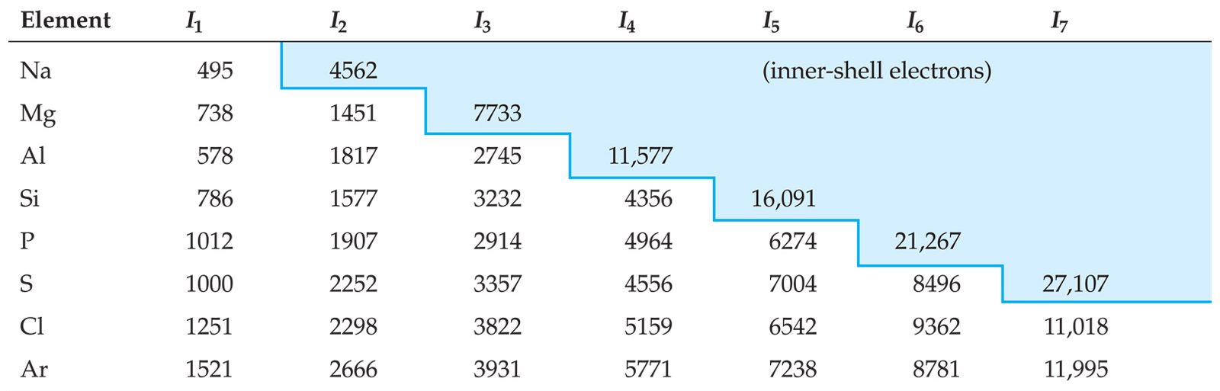
Ionization Energy
It requires more energy to remove each successive electron.
When all valence electrons have been removed, the ionization energy takes a quantum leap.

Slide 21
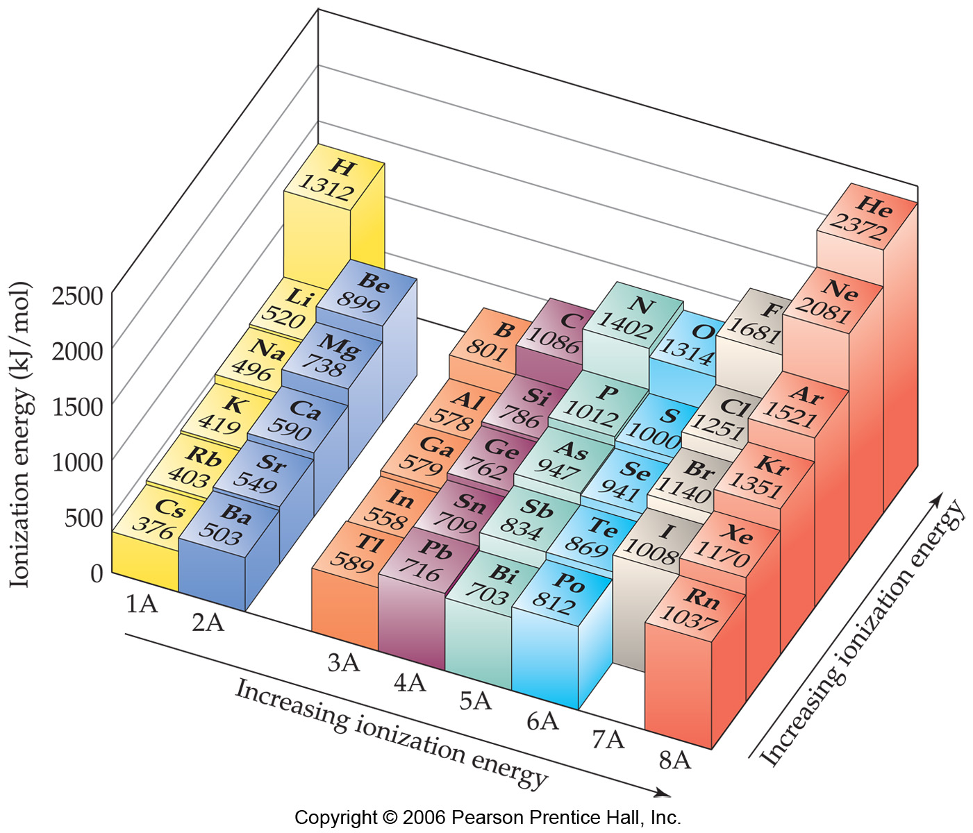
Trends in First Ionization Energies
going down a column, less energy to remove the first electron.
  For atoms in the same group, Z_{eff} is essentially the same, but the valence electrons are farther from the nucleus.

Slide 22
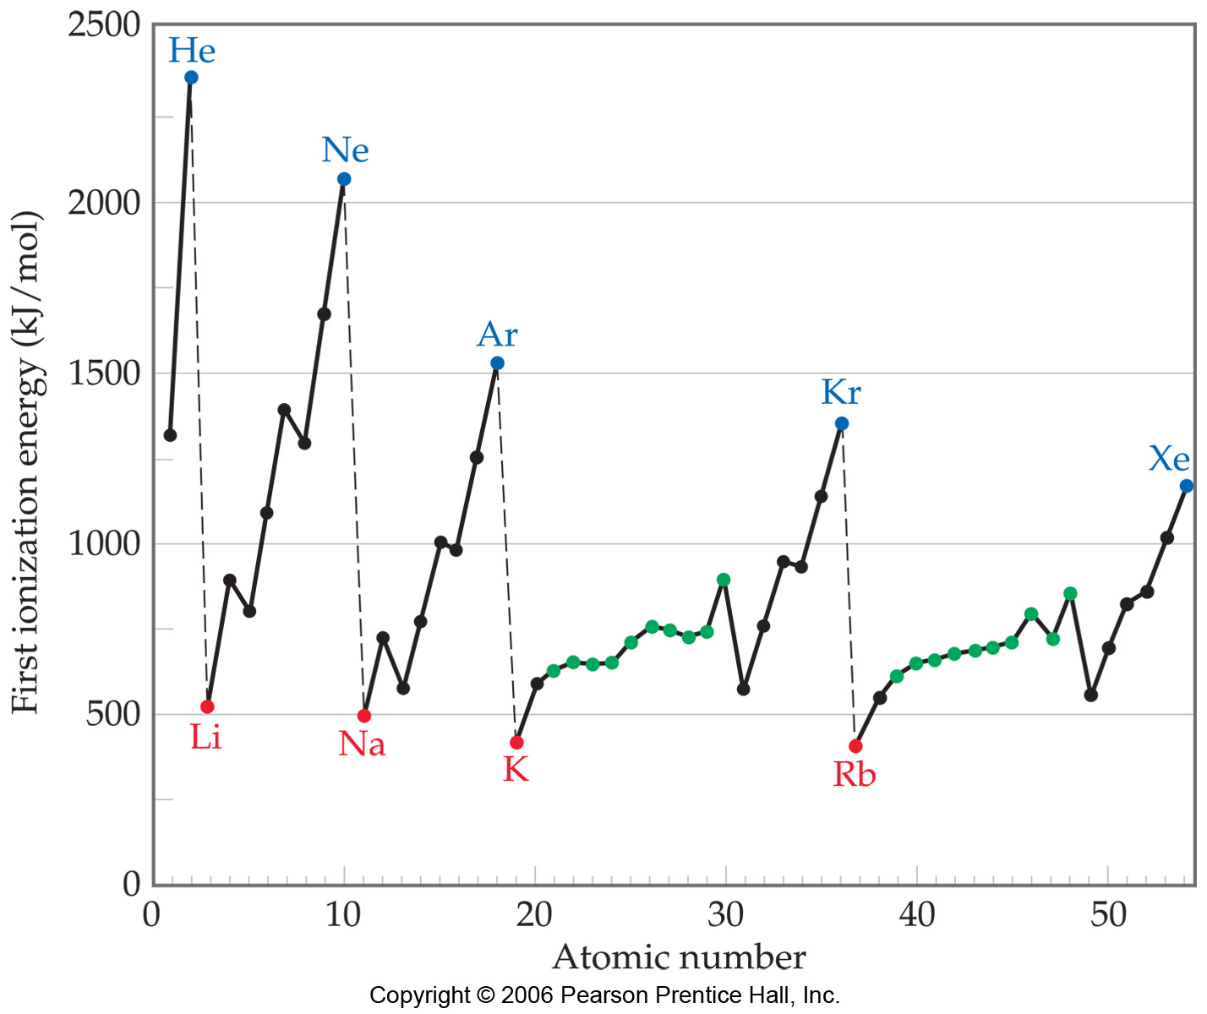
Trends in First Ionization Energies
Generally, it gets harder to remove an electron going across.
  As you go from left to to right, Z_{eff} increases.

Slide 23
Trends in First Ionization Energies
On a smaller scale, there are two jags in each line. Why?

Slide 24
Trends in First Ionization Energies
The first occurs between Groups IIA and IIIA.
Electron removed from p-orbital rather than s-orbital
  Electron farther from nucleus
  Small amount of repulsion by s electrons.

Slide 25
Trends in First Ionization Energies
The second occurs between Groups VA and VIA.
  Electron removed comes from doubly occupied orbital.
  Repulsion from other electron in orbital helps in its removal.
versus:

Slide 26
Electron Affinity
Energy change accompanying addition of electron to gaseous atom:
Cl + e⁻ ⎯⎯→ Cl⁻

Slide 27
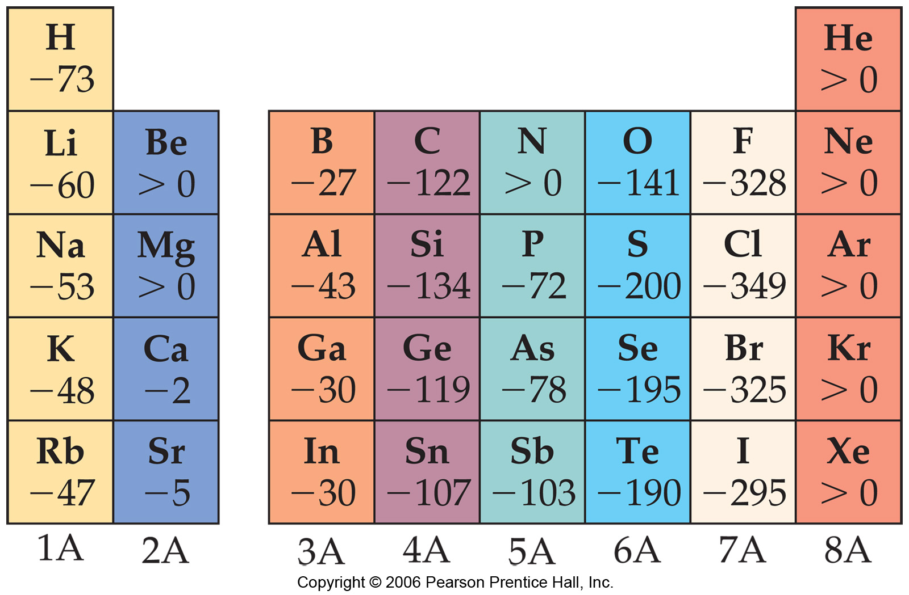
Trends in Electron Affinity
In general, electron affinity becomes more exothermic as you go from left to right across a row.

Slide 28
Trends in Electron Affinity
There are also two discontinuities in this trend.

Slide 29
Trends in Electron Affinity
The first occurs between Groups IA and IIA.
  Added electron must go in p-orbital, not s-orbital.
  Electron is farther from nucleus and feels repulsion from s-electrons.

Slide 30
Trends in Electron Affinity
The second occurs between Groups IVA and VA.
  Group VA has no empty orbitals.
  Extra electron must go into occupied orbital, creating repulsion.

Slide 31
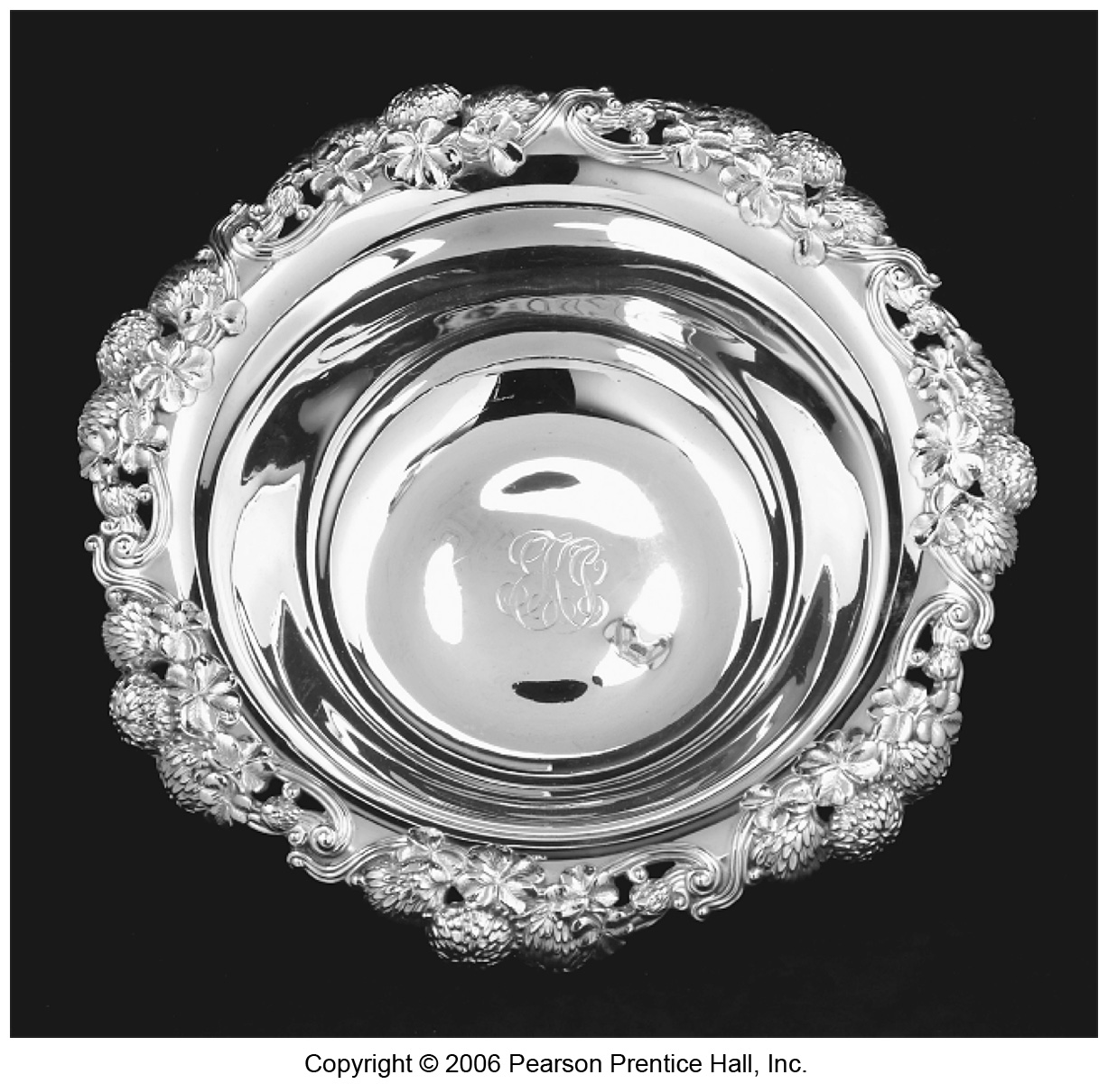
Metals
Tend to be lustrous, malleable, ductile, and good conductors of heat and electricity.

Slide 32
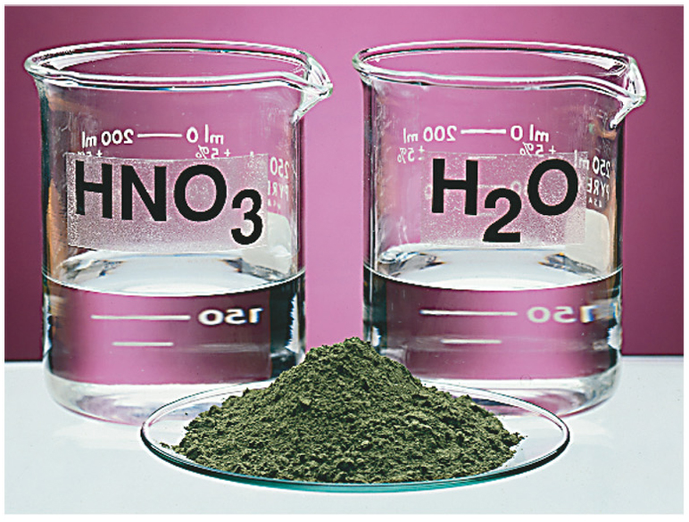
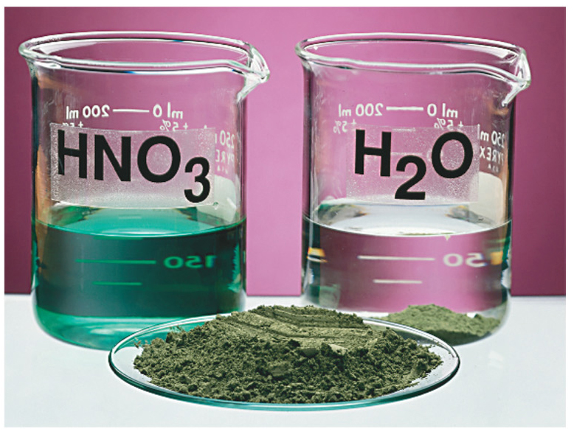
Metals
Compounds formed between metals and nonmetals tend to be ionic.
Metal oxides tend to be basic.

Slide 33
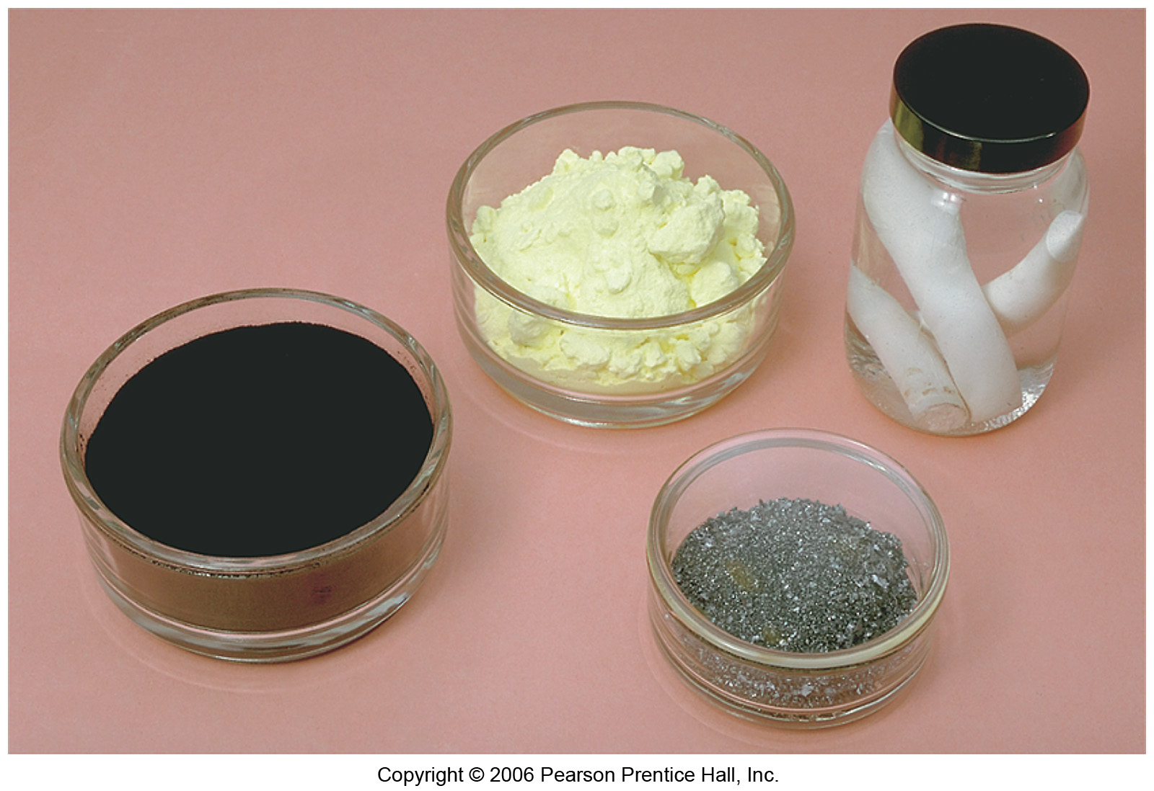
Nonmetals
Dull, brittle substances that are poor conductors of heat and electricity.
Tend to gain electrons in reactions with metals to acquire noble gas configuration.

Slide 34
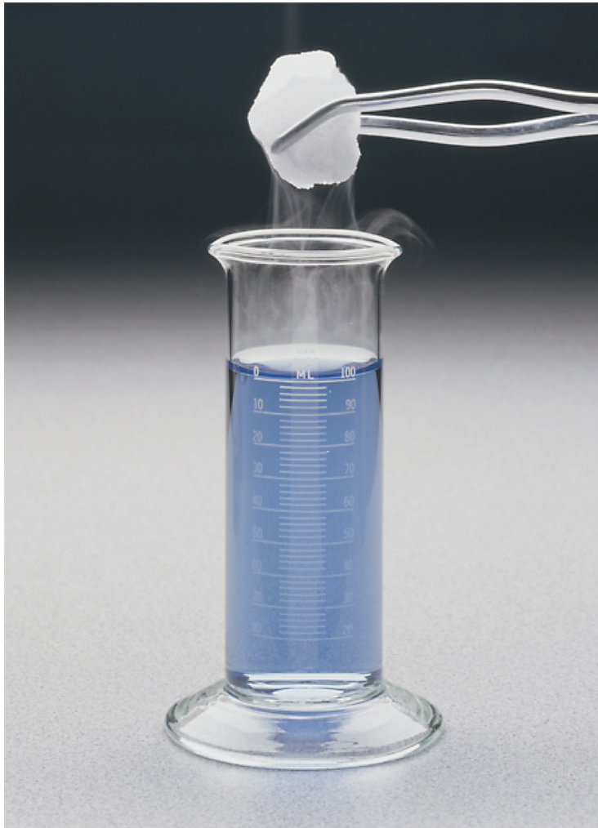
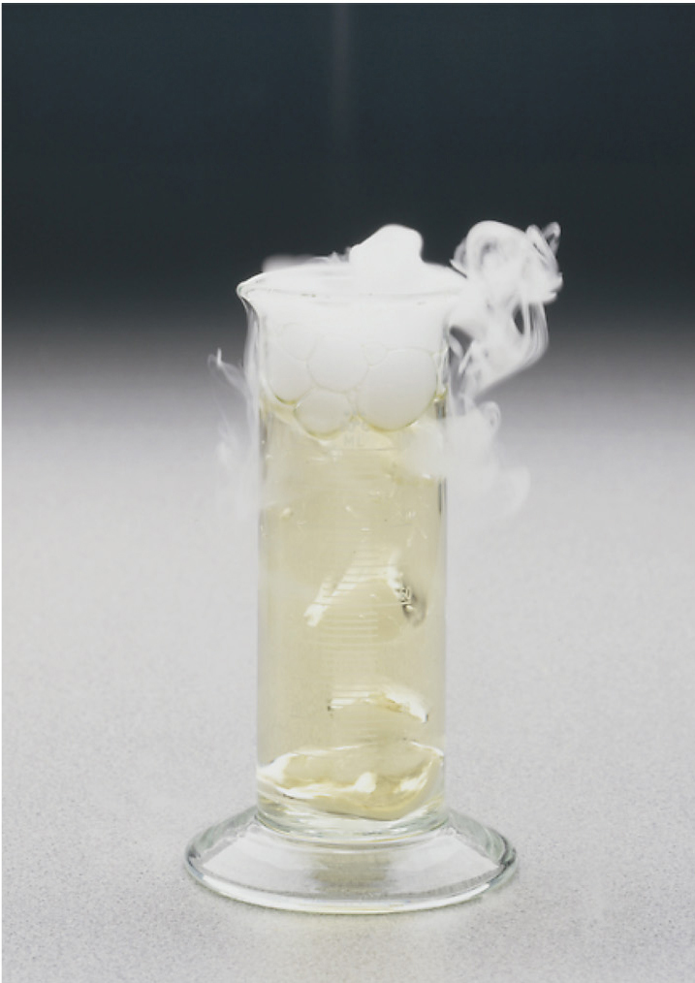
Nonmetals
Substances containing only nonmetals are molecular compounds.
Most nonmetal oxides are acidic.

Slide 35
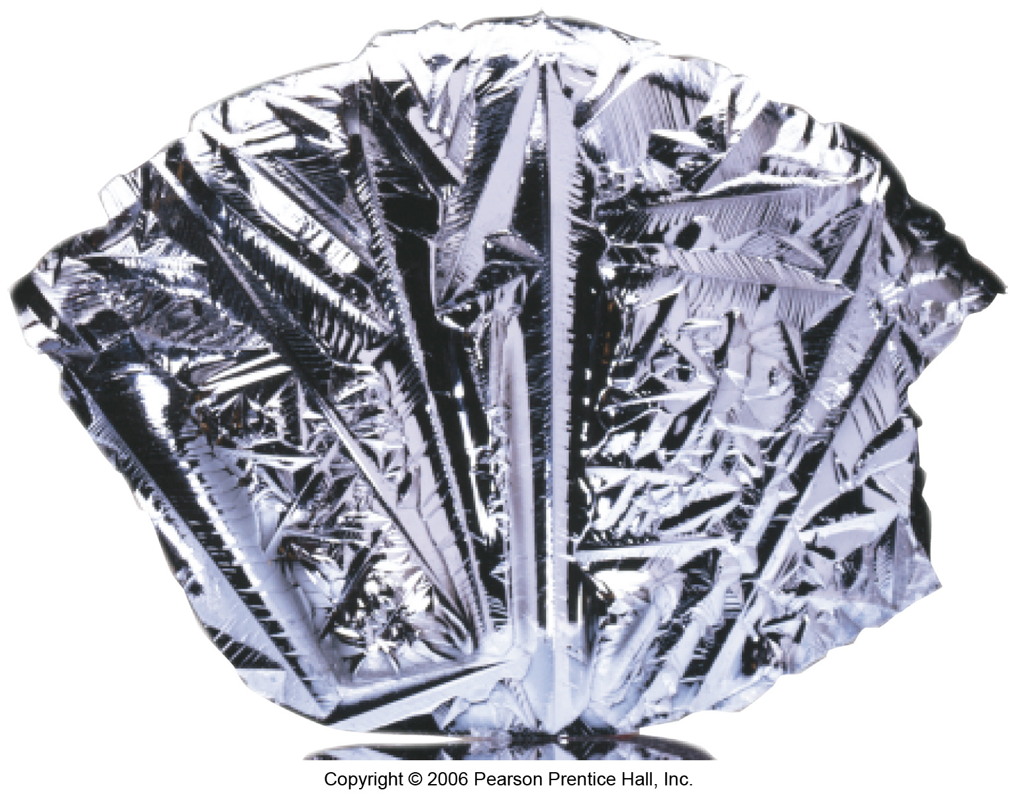
Metalloids
Have some characteristics of metals, some of nonmetals.
For instance, silicon looks shiny, but is brittle and fairly poor conductor.

Slide 36
Thank You

