Slide 1
The d Block Elements
:- Asst. Prof. Sachin P Patil
Chemistry Department
S T Co-Op Education Society’s, Science Senior College, Shahada.

Slide 2
General features of transition metals
This presentation explains what a transition metal is in terms of its electronic structure, and then goes on to look at the general features of transition metal chemistry.
These include
variable oxidation state (oxidation number)
complex ion formation
coloured ions
catalytic activity

Slide 4
What is a transition metal?
The terms transition metal (or element) and d block element are sometimes used as if they mean the same thing.
They don't - there's a subtle difference between the two terms.

Slide 5
d block elements
You will remember that when you are building the Periodic Table and working out where to put the electrons, something odd happens after argon.
At argon, the 3s and 3p levels are full, but rather than fill up the 3d levels next, the 4s level fills instead to give potassium and then calcium.
Only after that do the 3d levels fill.

Slide 6
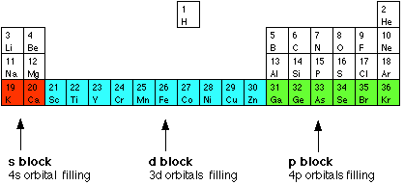
d block elements
The elements in the Periodic Table which correspond to the d sublevels filling are called d block elements. The first row of these is shown in the shortened form of the Periodic Table below.

Slide 8
Transition metals
Not all d block elements count as transition metals! There are discrepancies between the various syllabuses, but the majority use the definition:
A transition metal is one which forms one or more stable ions which have incompletely filled d orbitals.

Slide 14
Forming transition metal ions
The rule is quite simple. Take the 4s electrons off first, and then as many 3d electrons as necessary to produce the correct positive charge.

Slide 25
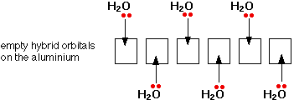
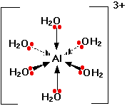
Only one lone pair is shown on each water molecule. The other lone pair is pointing away from the aluminium and so isn't involved in the bonding. The resulting ion looks like this:
Dotted arrows represent lone pairs coming from water molecules behind the plane of the screen or paper. Wedge shaped arrows represent bonds from water molecules in front of the plane of the screen or paper.

Slide 29
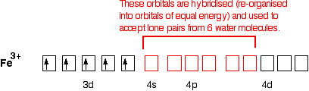
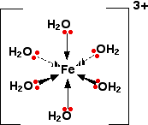
Once the co-ordinate bonds have been formed, the ion looks exactly the same as the equivalent aluminium ion.
Because the iron is forming 6 bonds, the co-ordination number of the iron is 6.

Slide 31
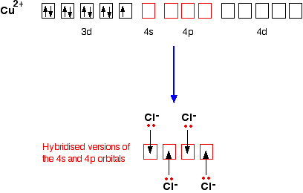
Only one of the 4 lone pairs on each chloride ion is shown. The other three are pointing away from the copper ion, and aren't involved in the bonding.

Slide 32
CuCl₄²⁻

Slide 34
Thank You

