Slide 1
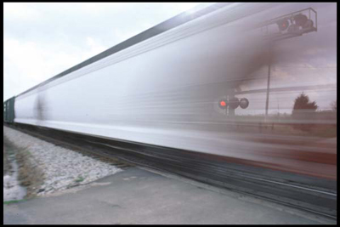
Work, Energy, Power, Momentum
By
Umesh Patil
Asst.Prof
Physics Department
S.T.E.s.& Co op E.S.Ltd.
Science Sr.college Shahada

Slide 2
Work, defined
Work carries a specific meaning in physics
  Simple form: work = force × distance
  W = F · d
Work can be done by you, as well as on you
  Are you the pusher or the pushee
Work is a measure of expended energy
  Work makes you tired
Machines make work easy (ramps, levers, etc.)
  Apply less force over larger distance for same work

Slide 3
Working at an advantage
Often we’re limited by the amount of force we can apply.
  Putting “full weight” into wrench is limited by your mg
Ramps, levers, pulleys, etc. all allow you to do the same amount of work, but by applying a smaller force over a larger distance
Work = Force × Distance
= Force × Distance

Slide 4
Ramps
Exert a smaller force over a larger distance to achieve the same change in gravitational potential energy (height raised)
Larger Force Small Force
Short Distance Long Distance
M

Slide 5
Gravitational Potential Energy
Gravitational Potential Energy near the surface of the Earth:
  ΔW = mg × Δh
Work =
Force
×
Distance
m
Δh
m

Slide 6
Ramp Example
Ramp 10 m long and 1 m high
Push 100 kg all the way up ramp
Would require mg = 980 N (220 lb) of force to lift directly (brute strength)
Work done is (980 N)×(1 m) = 980 N·m in direct lift
Extend over 10 m, and only 98 N (22 lb) is needed
  Something we can actually provide
  Excludes frictional forces/losses
1 m

Slide 7
Work Examples “Worked” Out
How much work does it take to lift a 30 kg suitcase onto the table, 1 meter high?
  W = (30 kg) × (9.8 m/s²) × (1 m) = 294 J
Unit of work (energy) is the N·m, or Joule (J)
  One Joule is 0.239 calories, or 0.000239 Calories (food)
Pushing a crate 10 m across a floor with a force of 250 N requires 2,500 J (2.5 kJ) of work
Gravity does 20 J of work on a 1 kg (10 N) book that it has pulled off a 2 meter shelf

Slide 8
Work is Exchange of Energy
Energy is the capacity to do work
Two main categories of energy
  Kinetic Energy: Energy of motion
    A moving baseball can do work
    A falling anvil can do work
  Potential Energy: Stored (latent) capacity to do work
    Gravitational potential energy (perched on cliff)
    Mechanical potential energy (like in compressed spring)
    Chemical potential energy (stored in bonds)
    Nuclear potential energy (in nuclear bonds)
Energy can be converted between types

Slide 9
Conversion of Energy
Falling object converts gravitational potential energy into kinetic energy
Friction converts kinetic energy into vibrational (thermal) energy
  makes things hot (rub your hands together)
  irretrievable energy
Doing work on something changes that object’s energy by amount of work done, transferring energy from the agent doing the work

Slide 10
Energy is Conserved!
The total energy (in all forms) in a “closed” system remains constant
This is one of nature’s “conservation laws”
  Conservation applies to:
    Energy (includes mass via E = mc²)
    Momentum
    Angular Momentum
    Electric Charge
Conservation laws are fundamental in physics, and stem from symmetries in our space and time
  Emmy Noether formulated this deep connection
  cedar.evansville.edu/~ck6/bstud/noether.html

Slide 11
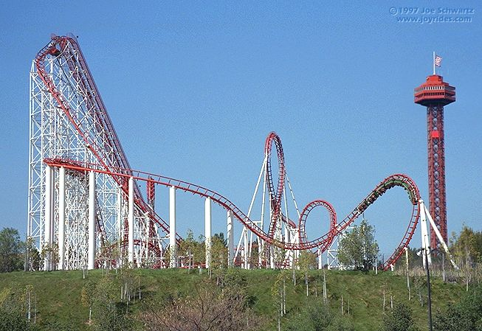
Energy Conservation Demonstrated
Roller coaster car lifted to initial height (energy in)
Converts gravitational potential energy to motion
Fastest at bottom of track
Re-converts kinetic energy back into potential as it climbs the next hill

Slide 12
Kinetic Energy
The kinetic energy for a mass in motion is
  K.E. = ½mv²
Example: 1 kg at 10 m/s has 50 J of kinetic energy
Ball dropped from rest at a height h (P.E. = mgh) hits the ground with speed v. Expect ½mv² = mgh
  h = ½gt²
  v = gt → v² = g²t²
  mgh = mg×(½gt²) = ½mg²t² = ½mv² sure enough
  Ball has converted its available gravitational potential energy into kinetic energy: the energy of motion

Slide 13

Kinetic Energy, cont.
Kinetic energy is proportional to v²…
Watch out for fast things!
  Damage to car in collision is proportional to v²
  Trauma to head from falling anvil is proportional to v², or to mgh (how high it started from)
  Hurricane with 120 m.p.h. packs four times the punch of gale with 60 m.p.h. winds

Slide 14
Energy Conversion/Conservation Example
10 m
P.E. = 98 J
K.E. = 0 J
8 m
P.E. = 73.5 J
K.E. = 24.5 J
Drop 1 kg ball from 10 m
  starts out with mgh = (1 kg)×(9.8 m/s²)×(10 m) = 98 J of gravitational potential energy
  halfway down (5 m from floor), has given up half its potential energy (49 J) to kinetic energy
    ½mv² = 49 J → v² = 98 m²/s² → v ≈ 10 m/s
  at floor (0 m), all potential energy is given up to kinetic energy
    ½mv² = 98 J → v² = 196 m²/s² → v = 14 m/s
6 m
P.E. = 49 J
K.E. = 49 J
4 m
P.E. = 24.5 J
K.E. = 73.5 J
2 m
P.E. = 0 J
K.E. = 98 J
0 m

Slide 15
Loop-the-Loop
In the loop-the-loop (like in a roller coaster), the velocity at the top of the loop must be enough to keep the train on the track:
  v²/r > g
Works out that train must start ½r higher than top of loop to stay on track, ignoring frictional losses
½r
r

Slide 16
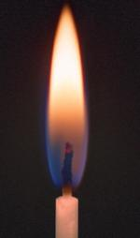
Heat: Energy Lost?
Heat is a form of energy
  really just randomized kinetic energy on micro scale
  lattice vibrations in solids, faster motions in liquids/gases
Heat is a viable (and common) path for energy flow
  Product of friction, many chemical, electrical processes
Hard to make heat energy do anything for you
  Kinetic energy of hammer can drive nail
  Potential energy in compressed spring can produce motion
  Heat is too disordered to extract useful work, generally
    notable exceptions: steam turbine found in most power plants
    Solar core : heat is important in enabling thermo-nuclear fusion

Slide 17
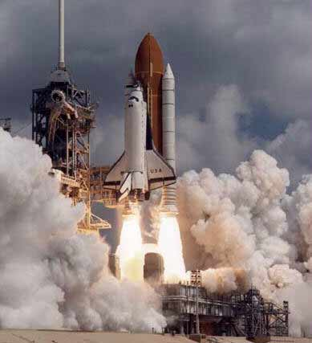
Power
Power is simply energy exchanged per unit time, or how fast you get work done (Watts = Joules/sec)
One horsepower = 745 W
Perform 100 J of work in 1 s, and call it 100 W
Run upstairs, raising your 70 kg (700 N) mass 3 m (2,100 J) in 3 seconds → 700 W output!
Shuttle puts out a few GW (gigawatts, or 10⁹ W) of power!

Slide 18
More Power Examples
Hydroelectric plant
  Drops water 20 m, with flow rate of 2,000 m³/s
  1 m³ of water is 1,000 kg, or 9,800 N of weight (force)
  Every second, drop 19,600,000 N down 20 m, giving
  392,000,000 J/s ≈ 400 MW of power
Car on freeway: 30 m/s, A = 3 m² → F_{drag}≈1800 N
  In each second, car goes 30 m → W = 1800×30 = 54 kJ
  So power = work per second is 54 kW (72 horsepower)
Bicycling up 10% (~6º) slope at 5 m/s (11 m.p.h.)
  raise your 80 kg self+bike 0.5 m every second
  mgh = 80×9.8×0.5 ≈ 400 J → 400 W expended

Slide 19
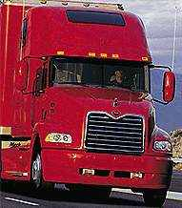
Momentum
Often misused word, though most have the right idea
Momentum, denoted p, is mass times velocity
  p = m·v
Momentum is a conserved quantity (and a vector)
  Often relevant in collisions (watch out for linebackers!)
News headline: Wad of Clay Hits Unsuspecting Sled
  1 kg clay ball strikes 5 kg sled at 12 m/s and sticks
  Momentum before collision: (1 kg)(12 m/s) + (5 kg)(0 m/s)
  Momentum after = 12 kg·m/s → (6 kg)·(2 m/s)

Slide 20
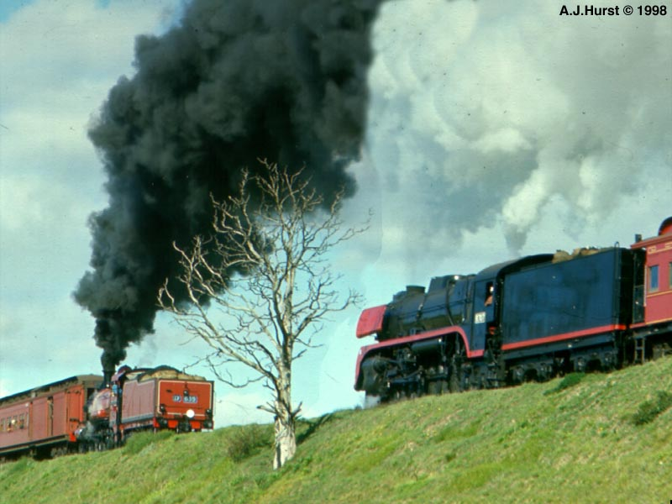
Collisions
Two types of collisions
  Elastic: Energy not dissipated out of kinetic energy
    Bouncy
  Inelastic: Some energy dissipated to other forms
    Sticky
Perfect elasticity unattainable (perpetual motion)

Slide 21
Elastic Collision: Billiard Balls
Whack stationary ball with identical ball moving at velocity v_{cue}
8
To conserve both energy and momentum, cue ball stops dead,
and 8-ball takes off with v_{cue}
8
8
Momentum conservation: mv_{cue} = mv_{cue, after} + mv_{8-ball}
Energy conservation: ½mv²_{cue} = ½mv²_{cue, after} + ½mv²_{8-ball}
The only way v₀ = v₁ + v₂ and v²₀ = v²₁ + v²₂ is if either v₁ or v₂ is 0.
Since cue ball can’t move through 8-ball, cue ball gets stopped.

Slide 22
Desk Toy Physics
The same principle applies to the suspended-ball desk toy, which eerily “knows” how many balls you let go…
Only way to simultaneously satisfy energy and momentum conservation
Relies on balls to all have same mass

Slide 23
Inelastic Collision
Energy not conserved (absorbed into other paths)
Non-bouncy: hacky sack, velcro ball, ball of clay
Momentum before = m₁v_{initial}
Momentum after = (m₁ + m₂)v_{final} = m₁v_{initial} (because conserved)
Energy before = ½m₁v²_{initial}
Energy after = ½ (m₁ + m₂)v²_{final} + heat energy

Slide 24
Questions
Twin trouble-makers rig a pair of swings to hang from the same hooks, facing each other. They get friends to pull them back (the same distance from the bottom of the swing) and let them go. When they collide in the center, which way do they swing (as a heap), if any? What if Fred was pulled higher than George before release?
A 100 kg ogre clobbers a dainty 50 kg figure skater while trying to learn to ice-skate. If the ogre is moving at 6 m/s before the collision, at what speed will the tangled pile be sliding afterwards?

Slide 25
Real-World Collisions
Is a superball elastic or inelastic?
  It bounces, so it’s not completely inelastic
  It doesn’t return to original height after bounce, so some energy must be lost
Superball often bounces 80% original height
  Golf ball → 65%
  Tennis ball → 55%
  Baseball → 30%
Depends also on surface, which can absorb some of the ball’s energy
  down comforter/mattress or thick mud would absorb

Slide 26
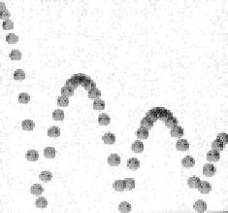
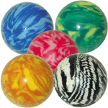
Superball Physics
During bounce, if force on/from floor is purely vertical, expect constant horizontal velocity
  constant velocity in absence of forces
  like in picture to upper right
BUT, superballs often behave contrary to intuition
  back-and-forth motion
  boomerang effect

Slide 27
Angular Momentum
Another conserved quantity is angular momentum, relating to rotational inertia:
Spinning wheel wants to keep on spinning, stationary wheel wants to keep still (unless acted upon by an external rotational force, or torque)
Newton’s laws for linear (straight-line) motion have direct analogs in rotational motion

Slide 28
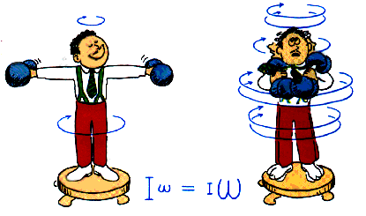
Angular Momentum
Angular momentum is proportional to rotation speed (ω) times rotational inertia (I)
Rotational inertia characterized by (mass)×(radius)² distribution in object

Slide 29
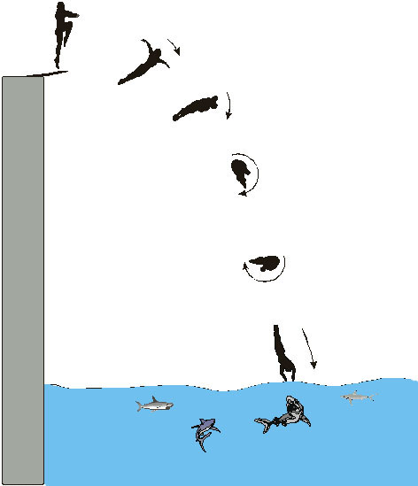
Angular Momentum Conservation
Speed up rotation by tucking in
Slow down rotation by stretching out
Seen in diving all the time
Figure skaters demonstrate impressively
Effect amplified by moving large masses to vastly different radii

Slide 30
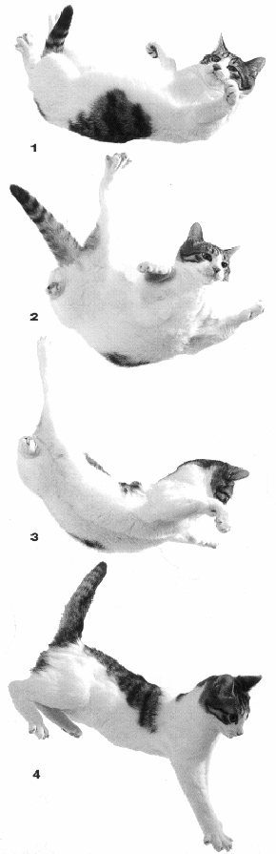

Do cats violate physical law?
Cats can quickly flip themselves to land on their feet
If not rotating before, where do they get their angular momentum?
There are ways to accomplish this, by a combination of contortion and varying rotational inertia

Slide 31
Thank You

