Slide 1
S.T.E.S. & Co-Op E.S. Ltd Science Senior College Shahada
ELE-301: Analog Communication:
Unit 1: Basics of Electronic communication
Prepared By: Dr. Ulhas S. Sonawane
Asst. Professor,
Electronics Department,
S.T.E.S. & Co-Op E.S. Ltd
Science Senior College Shahada

Slide 2
Index
1-1: Significance of Human Communication
1-2: Communication Systems
1-3: Types of Electronic Communication
1-4: Modulation and Multiplexing
1-5: The Electromagnetic Spectrum
1-6: Bandwidth
1-7: A Survey of Communication Applications

Slide 3
1-1: Significance of
Human Communication
Communication is the process of exchanging information.
Main barriers are language and distance.
Contemporary society’s emphasis is now the accumulation, packaging, and exchange of information.

Slide 4
1-1: Significance of
Human Communication
Methods of communication:
  Face to face
  Signals
  Written word (letters)
  Electrical innovations:
    Telegraph
    Telephone
    Radio
    Television
    Internet (computer)

Slide 5
1-2: Communication Systems
Basic components:
  Transmitter
  Channel or medium
  Receiver
Noise degrades or interferes with transmitted information.

Slide 6
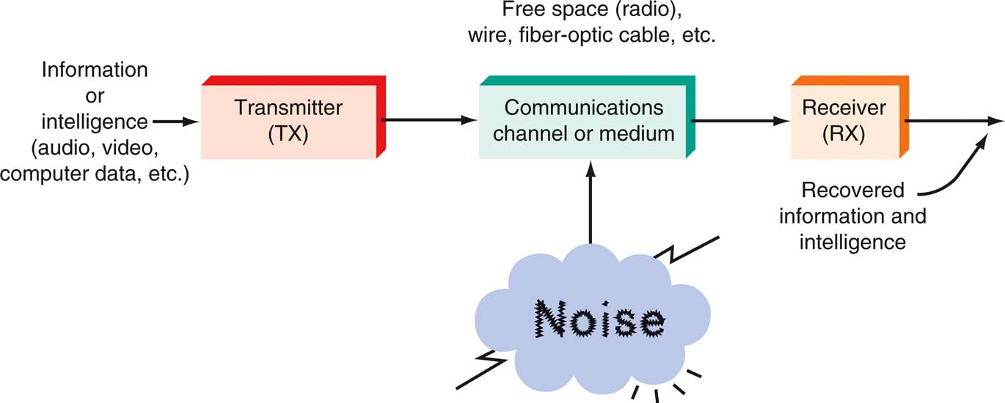
1-2: Communication Systems
Figure 1-2: A general model of all communication systems.

Slide 7
1-2: Communication Systems
Transmitter
  The transmitter is a collection of electronic components and circuits that converts the electrical signal into a signal suitable for transmission over a given medium.
  Transmitters are made up of oscillators, amplifiers, tuned circuits and filters, modulators, frequency mixers, frequency synthesizers, and other circuits.

Slide 8
1-2: Communication Systems
Communication Channel
  The communication channel is the medium by which the electronic signal is sent from one place to another.
  Types of media include
    Electrical conductors
    Optical media
    Free space
    System-specific media (e.g., water is the medium for sonar).

Slide 9
1-2: Communication Systems
Receivers
  A receiver is a collection of electronic components and circuits that accepts the transmitted message from the channel and converts it back into a form understandable by humans.
  Receivers contain amplifiers, oscillators, mixers, tuned circuits and filters, and a demodulator or detector that recovers the original intelligence signal from the modulated carrier.

Slide 10
1-2: Communication Systems
Transceivers
  A transceiver is an electronic unit that incorporates circuits that both send and receive signals.
  Examples are:
    Telephones
    Fax machines
    Handheld CB radios
    Cell phones
    Computer modems

Slide 11
1-2: Communication Systems
Attenuation
  Signal attenuation, or degradation, exists in all media of wireless transmission. It is proportional to the square of the distance between the transmitter and receiver.

Slide 12
1-2: Communication Systems
Noise
  Noise is random, undesirable electronic energy that enters the communication system via the communicating medium and interferes with the transmitted message.

Slide 13
1-3: Types of Electronic Communication
Electronic communications are classified according to whether they are
  One-way (simplex) or two-way (full duplex or half duplex) transmissions
  Analog or digital signals.

Slide 14
1-3: Types of Electronic Communication
Simplex
  The simplest method of electronic communication is referred to as simplex.
  This type of communication is one-way. Examples are:
    Radio
    TV broadcasting
    Beeper (personal receiver)

Slide 15
1-3: Types of Electronic Communication
Full Duplex
  Most electronic communication is two-way and is referred to as duplex.
  When people can talk and listen simultaneously, it is called full duplex. The telephone is an example of this type of communication.

Slide 16
1-3: Types of Electronic Communication
Half Duplex
  The form of two-way communication in which only one party transmits at a time is known as half duplex. Examples are:
    Police, military, etc. radio transmissions
    Citizen band (CB)
    Family radio
    Amateur radio

Slide 17
1-3: Types of Electronic Communication
Analog Signals
  An analog signal is a smoothly and continuously varying voltage or current. Examples are:
    Sine wave
    Voice
    Video (TV)

Slide 18
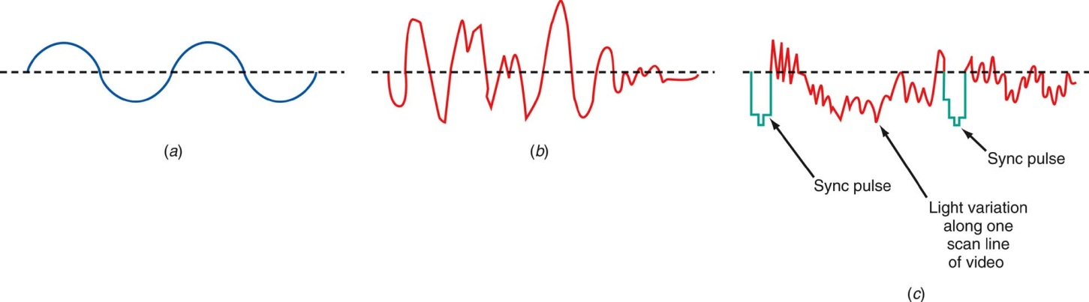
1-3: Types of Electronic Communication
Figure 1-5: Analog signals (a) Sine wave “tone.” (b) Voice. (c) Video (TV) signal.

Slide 19
1-3: Types of Electronic Communication
Digital Signals
  Digital signals change in steps or in discrete increments.
  Most digital signals use binary or two-state codes. Examples are:
    Telegraph (Morse code)
    Continuous wave (CW) code
    Serial binary code (used in computers)

Slide 20
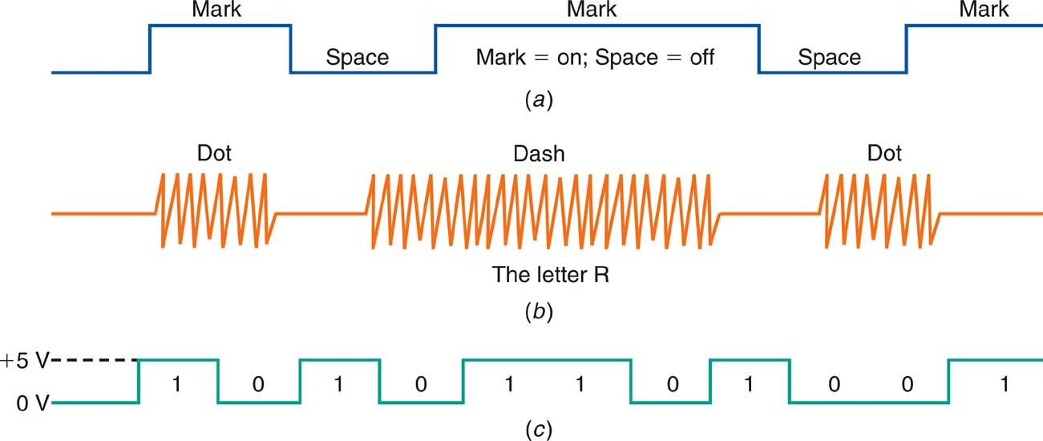
1-3: Types of Electronic Communication
Figure 1-6: Digital signals (a) Telegraph (Morse code). (b) Continuous-wave (CW) code. (c) Serial binary code.

Slide 21
1-3: Types of Electronic Communication
Digital Signals
  Many transmissions are of signals that originate in digital form but must be converted to analog form to match the transmission medium.
    Digital data over the telephone network.
    Analog signals.
      They are first digitized with an analog-to-digital (A/D) converter.
      The data can then be transmitted and processed by computers and other digital circuits.

Slide 22
1-4: Modulation and Multiplexing
Modulation and multiplexing are electronic techniques for transmitting information efficiently from one place to another.
Modulation makes the information signal more compatible with the medium.
Multiplexing allows more than one signal to be transmitted concurrently over a single medium.

Slide 23
1-4: Modulation and Multiplexing
Baseband Transmission
  Baseband information can be sent directly and unmodified over the medium or can be used to modulate a carrier for transmission over the medium.
    In telephone or intercom systems, the voice is placed on the wires and transmitted.
    In some computer networks, the digital signals are applied directly to coaxial or twisted-pair cables for transmission.

Slide 24
1-4: Modulation and Multiplexing
Broadband Transmission
  A carrier is a high frequency signal that is modulated by audio, video, or data.
  A radio-frequency (RF) wave is an electromagnetic signal that is able to travel long distances through space.

Slide 25
1-4: Modulation and Multiplexing
Broadband Transmission
  A broadband transmission takes place when a carrier signal is modulated, amplified, and sent to the antenna for transmission.
  The two most common methods of modulation are:
    Amplitude Modulation (AM)
    Frequency Modulation (FM)
  Another method is called phase modulation (PM), in which the phase angle of the sine wave is varied.

Slide 26
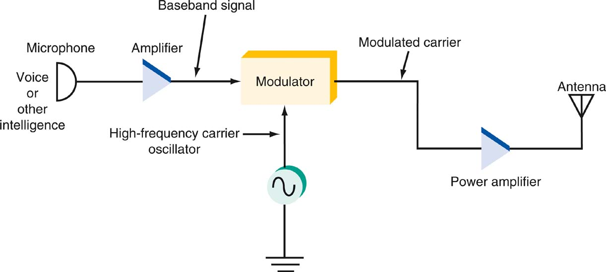
1-4: Modulation and Multiplexing
Figure 1-7: Modulation at the transmitter.

Slide 27
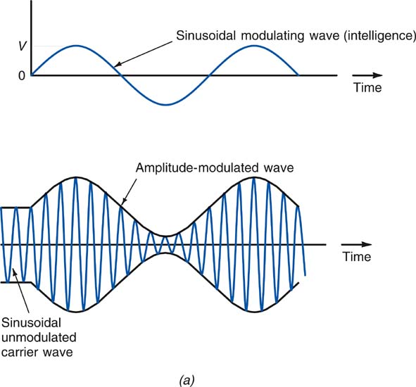
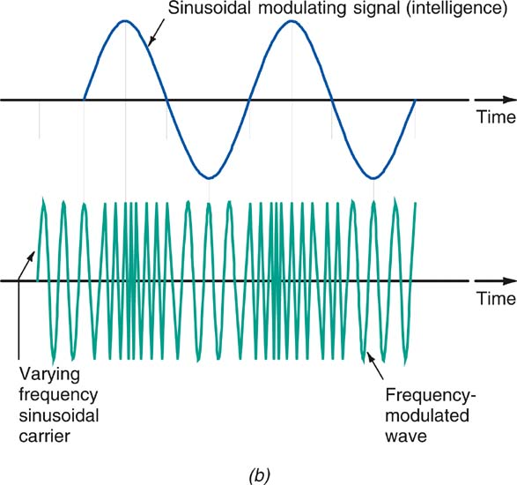
1-4: Modulation and Multiplexing
Figure 1-8: Types of modulation. (a) Amplitude modulation. (b) Frequency modulation.

Slide 28
1-4: Modulation and Multiplexing
Broadband Transmission
  Frequency-shift keying (FSK) takes place when data is converted to frequency-varying tones.
  Devices called modems (modulator-demodulator) translate the data from digital to analog and back again.
  Demodulation or detection takes place in the receiver when the original baseband (e.g. audio) signal is extracted.

Slide 29
1-4: Modulation and Multiplexing
Multiplexing
  Multiplexing is the process of allowing two or more signals to share the same medium or channel.
  The three basic types of multiplexing are:
    Frequency division
    Time division
    Code division

Slide 30
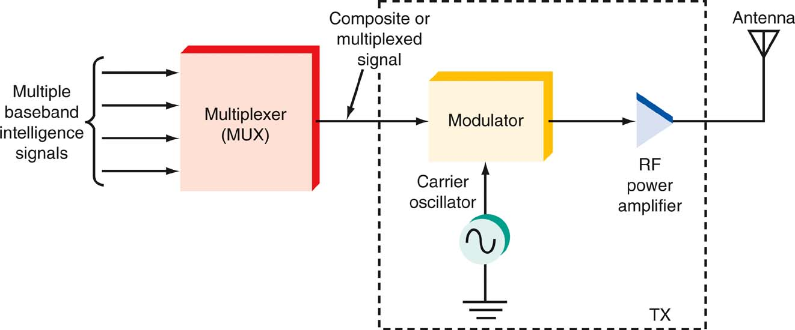
1-4: Modulation and Multiplexing
Figure 1-11: Multiplexing at the transmitter.

Slide 31
1-5: The Electromagnetic Spectrum
The range of electromagnetic signals encompassing all frequencies is referred to as the electromagnetic spectrum.

Slide 32
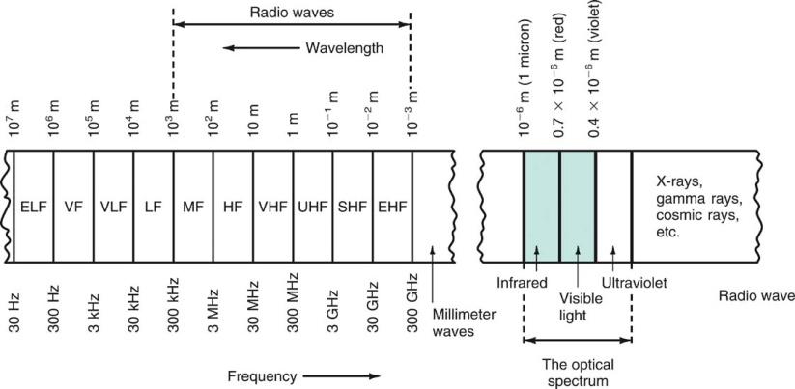
1-5: The Electromagnetic Spectrum
Figure 1-13: The electromagnetic spectrum.

Slide 33
1-5: The Electromagnetic Spectrum
Frequency and Wavelength: Frequency
  A signal is located on the frequency spectrum according to its frequency and wavelength.
  Frequency is the number of cycles of a repetitive wave that occur in a given period of time.
  A cycle consists of two voltage polarity reversals, current reversals, or electromagnetic field oscillations.
  Frequency is measured in cycles per second (cps).
  The unit of frequency is the hertz (Hz).

Slide 34
1-5: The Electromagnetic Spectrum
Frequency and Wavelength: Wavelength
  Wavelength is the distance occupied by one cycle of a wave and is usually expressed in meters.
  Wavelength is also the distance traveled by an electromagnetic wave during the time of one cycle.
  The wavelength of a signal is represented by the Greek letter lambda (λ).

Slide 35
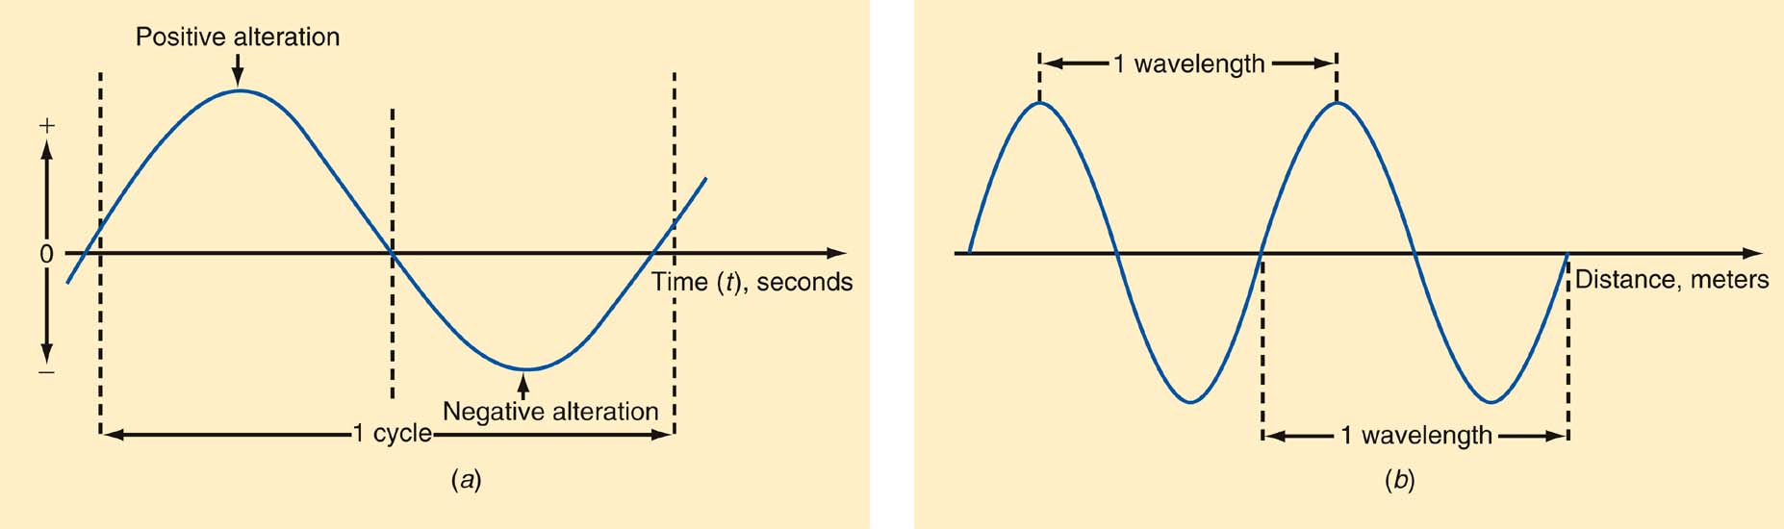
1-5: The Electromagnetic Spectrum
Figure 1-15: Frequency and wavelength. (a) One cycle. (b) One wavelength.

Slide 36
1-5: The Electromagnetic Spectrum
Frequency and Wavelength: Wavelength
Wavelength (λ) = speed of light ÷ frequency
Speed of light = 3 × 10⁸ meters/second
Therefore:
λ = 3 × 10⁸ / f
  Example:
  What is the wavelength if the frequency is 4MHz?
λ = 3 × 10⁸ / 4 MHz
= 75 meters (m)

Slide 37
1-5: The Electromagnetic Spectrum
Frequency Ranges from 30 Hz to 300 GHz
  The electromagnetic spectrum is divided into segments:
Extremely Low Frequencies (ELF) | 30–300 Hz.
Voice Frequencies (VF) | 300–3000 Hz.
Very Low Frequencies (VLF) | include the higher end of the human hearing range up to about 20 kHz.
Low Frequencies (LF) | 30–300 kHz.
Medium Frequencies (MF) | 300–3000 kHz AM radio 535–1605 kHz.

Slide 38
1-5: The Electromagnetic Spectrum
Frequency Ranges from 30 Hz to 300 GHz
High Frequencies (HF) (short waves; VOA, BBC broadcasts; government and military two-way communication; amateur radio, CB. | 3–30 MHz
Very High Frequencies (VHF) FM radio broadcasting (88–108 MHz), television channels 2–13. | 30–300 MHz
Ultra High Frequencies (UHF) TV channels 14–67, cellular phones, military communication. | 300–3000 MHz

Slide 39
1-5: The Electromagnetic Spectrum
Frequency Ranges from 30 Hz to 300 GHz
Microwaves and Super High Frequencies (SHF) Satellite communication, radar, wireless LANs, microwave ovens | 1–30 GHz
Extremely High Frequencies (EHF) Satellite communication, computer data, radar | 30–300 GHz

Slide 40
1-5: The Electromagnetic Spectrum
Optical Spectrum
  The optical spectrum exists directly above the millimeter wave region.
  Three types of light waves are:
    Infrared
    Visible spectrum
    Ultraviolet

Slide 41
1-5: The Electromagnetic Spectrum
Optical Spectrum: Infrared
  Infrared radiation is produced by any physical equipment that generates heat, including our bodies.
  Infrared is used:
    In astronomy, to detect stars and other physical bodies in the universe,
    For guidance in weapons systems, where the heat radiated from airplanes or missiles can be detected and used to guide missiles to targets.
    In most new TV remote-control units, where special coded signals are transmitted by an infrared LED to the TV receiver to change channels, set the volume, and perform other functions.
    In some of the newer wireless LANs and all fiber-optic communication.

Slide 42
1-5: The Electromagnetic Spectrum
Optical Spectrum: The Visible Spectrum
  Just above the infrared region is the visible spectrum we refer to as light.
  Red is low-frequency or long-wavelength light
  Violet is high-frequency or short-wavelength light.
  Light waves’ very high frequency enables them to handle a tremendous amount of information (the bandwidth of the baseband signals can be very wide).

Slide 43
1-5: The Electromagnetic Spectrum
Optical Spectrum: Ultraviolet
  Ultraviolet is not used for communication
  Its primary use is medical.

Slide 44
1-6: Bandwidth
Bandwidth (BW) is that portion of the electromagnetic spectrum occupied by a signal.
Channel bandwidth refers to the range of frequencies required to transmit the desired information.

Slide 45
1-6: Bandwidth
More Room at the Top
  Today, virtually the entire frequency spectrum between approximately 30 kHz and 300 MHz has been spoken for.
  There is tremendous competition for these frequencies, between companies, individuals, and government services in individual carriers and between the different nations of the world.
  The electromagnetic spectrum is one of our most precious natural resources.

Slide 46
1-6: Bandwidth
More Room at the Top
  Communication engineering is devoted to making the best use of that finite spectrum.
  Great effort goes into developing communication techniques that minimize the bandwidth required to transmit given information and thus conserve spectrum space.
  This provides more room for additional communication channels and gives other services or users an opportunity to take advantage of it.

Slide 47
1-6: Bandwidth
Spectrum Management and Standards
  Spectrum management is provided by agencies set up by the United States and other countries to control spectrum use.
    The Federal Communications Commission (FCC) and the National Telecommunications and Information Administration (NTIA) are two agencies that deal in spectrum management.
  Standards are specifications and guidelines necessary to ensure compatibility between transmitting and receiving equipment.

Slide 48
1-7: A Survey of
Communications Applications
Simplex
  AM and FM broadcasting
  Digital radio
  TV broadcasting
  Digital television (DTV)
  Cable television
  Facsimile
  Wireless remote control
  Paging services
  Navigation and direction-finding services
  Telemetry
  Radio astronomy
  Surveillance
  Music services
  Internet radio and video

Slide 49
1-7: A Survey of
Communications Applications
Duplex
  Telephones
  Two-way radio
  Radar
  Sonar
  Amateur radio
  Citizens radio
  Family Radio service
  The Internet
  Wide-area networks (WANs)
  Metropolitan-area networks (MANs)
  Local area networks (LANs)

