Slide 1
T.Y.Biotechnology
Sub-Agriculture Biotechnology
Presented by
Pradnya V. Dhivare
(Dept. of Biotechnology)

Slide 2
Nitrogen Fixation and Biofertilizer
Definition of Nitrogen Fixation:
Nitrogen fixation is a process by which nitrogen in the air is converted into ammonia (NH₃) or related nitrogenous compounds by some nitrogen-fixing bacteria have symbiotic relationships with some plant groups, especially legumes.
The prokaryotes/microorganism are called nitrogen fixer.

Slide 3
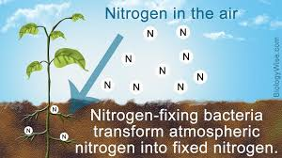

Slide 4
Symbiotic Nitrogen Fixation
Definition : Symbiotic nitrogen fixation is part of a mutualistic relationship in which plants provide a niche and fixed carbon to bacteria in exchange for fixed nitrogen.
Examples of symbiotic nitrogen-fixing bacteria include Rhizobium, which is associated with plants in the pea family, and various Azospirillum species, which are associated with cereal grasses.

Slide 5
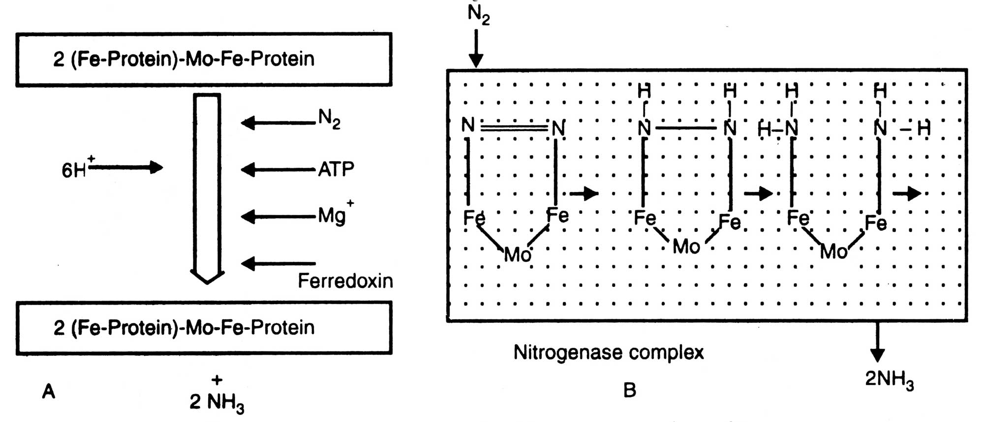
Mechanism of N₂ Fixation

Slide 6
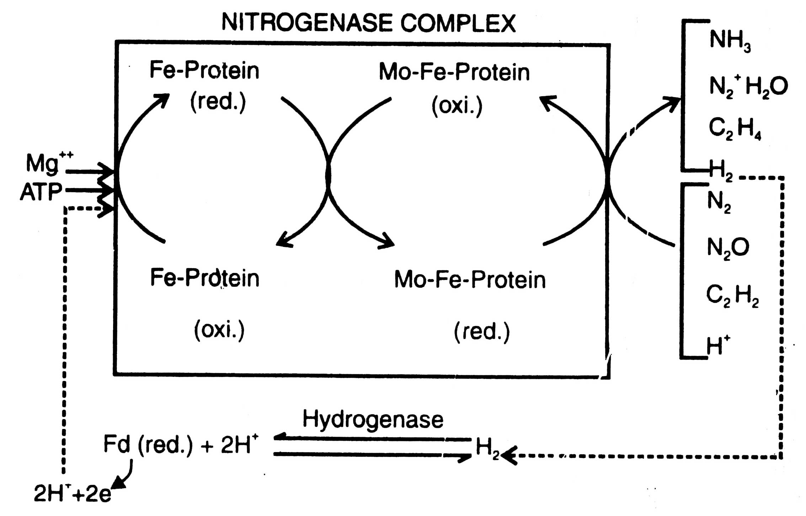
Dinitrogenase complex

Slide 7
Rhizobium symbiosis
Rhizobium is a genus of Gram-negative soil bacteria that fix nitrogen.
The bacteria colonize plant cells within root nodules, where they convert atmospheric nitrogen into ammonia using the enzyme nitrogenase and then provide organic nitrogenous compounds such as glutamine or ureides to the plant.

Slide 8
Rhizobia are found in the soil and after infection, produce nodules in the legume where they fix nitrogen gas (N₂) from the atmosphere turning it into a more readily useful form of nitrogen. From here, the nitrogen is exported from nodules and used for growth in the legume.
Example of Rhizobia-
Rhizobium leguminosarum
Rhizobium meliloti

Slide 9
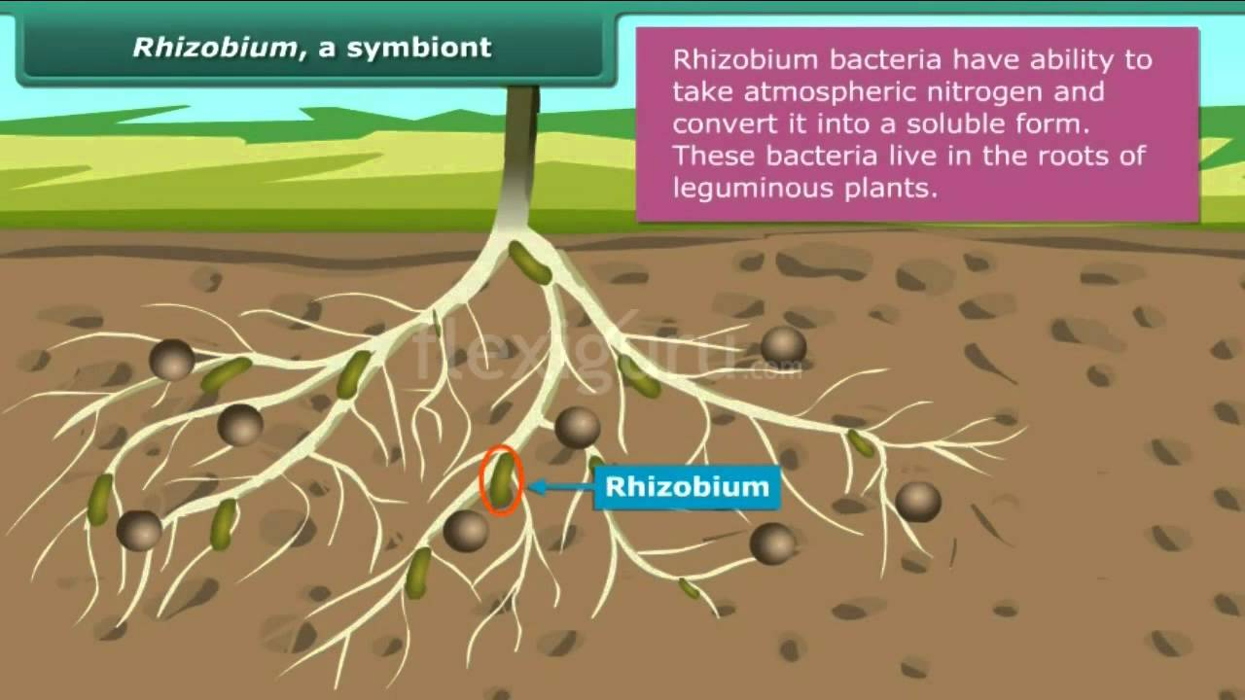
Figure of Rhizobium

Slide 10
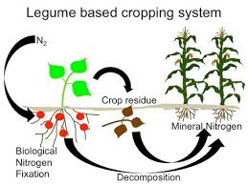
Legum

Slide 11
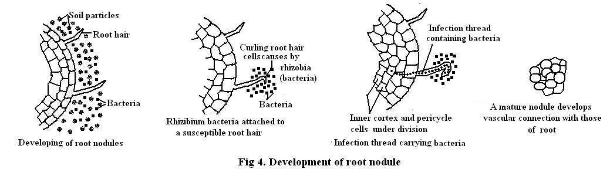
Nodule Development

Slide 12
Non Symbiotic Nitrogen fixation
Microorganisms which pass independent life and fix atmospheric nitrogen are known as free living diazotrophs.
There are two groups of such micro-organisms : bacteria and cyanobacteria (blue-green algae).
Based on the mode of nutrition (carbon, nitrogen and oxygen and requirement of reducing groups) bacteria are divided into (i) aerobic bacteria (Azonomas, Azotobacter, Beijerinckia, Mycobacterium, Methylomonas)
(ii) facultative anaerobic bacteria (Bacillus, Enterobacter, Klebsiella, etc.)
(iii) anaerobic bacteria (Clostridium, Desulfovibrio, etc.)
(iv) photosynthetic bacteria (Rhodomicrobium, Rhodopseudomonas, Rhodospirillum, Chromatium, Chlorobium,

Slide 13
Biofertilizer
Defination -A biofertilizer is a substance which contains living microorganisms when applied to seeds, plant surfaces or soil, colonize the rhizosphere or the interior of the plant and promotes growth by increasing the supply or availability of primary nutrients to the host plant.

Slide 14
Biofertilizers include the following:
symbiotic nitrogen fixers, Rhizobium spp.;
non-symbiotic, free-living nitrogen fixers (Azotobacter, Azospirillum, etc.);
algal biofertilizers (blue-green algae or blue-green algae in association with Azolla);
phosphate-solubilising bacteria;
mycorrhizae;
organic fertilizers.

Slide 15
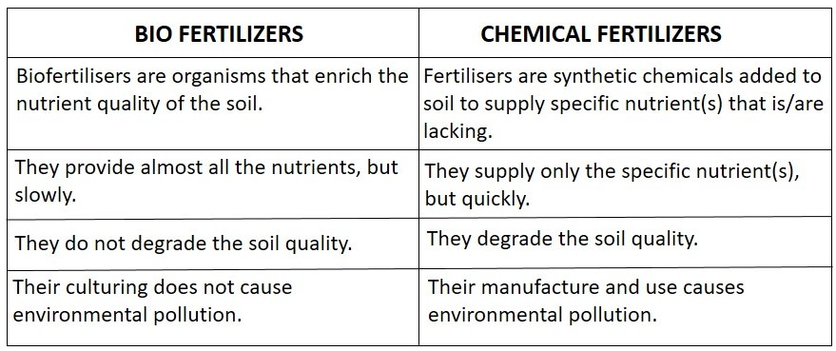
Difference between Bio and Chemical Fertilizers

