Slide 1

Haloalkanes
And
Haloarenes
BY
ASST.PROF.LALITA A. PATIL
ST CO-OP SOCIETY SCI.SR.COLLEGE,
SHAHADA

Slide 2
The Introduction
The replacement of hydrogen atom(s) in a hydrocarbon, aliphatic or aromatic, by halogen atom(s) results in the formation of
alkyl halide (haloalkane) and aryl halide (haloarene), respectively The compounds containing more than one halogen atoms are commonly called as polyhaloalkanes, or polyhaloarenes depending
upon the hydrocarbon residue in the molecule. Haloalkanes and haloarenes are important intermediates in synthetic organic
chemistry due to, (i) the greater ease with which these derivatives can be prepared. (ii) their high reactivity.

Slide 3

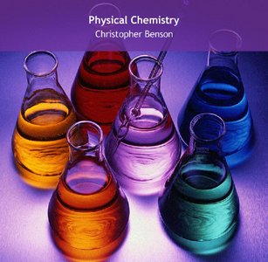
classification

Slide 4
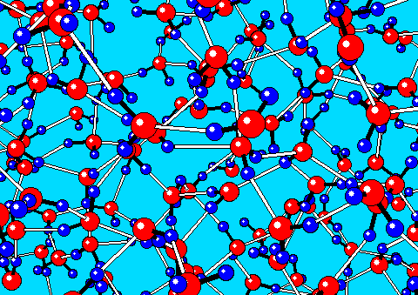
CLASSIfICATION
The compounds formed by replacement of one or more Hydrogen atoms from hydrocarbon molecule by corrersponding number
of halogen atoms are called halogen derivatives or halides.

Slide 5
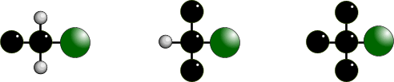
STRUCTURE OF HALOGENOALKANES
Format Contain the functional group C-X where X is a halogen (F,Cl,Br or I)
Halogenoalkanes - halogen is attached to an aliphatic skeleton - alkyl group
Haloarenes - halogen is attached directly to a benzene (aromatic) ring
Structural
difference Halogenoalkanes are classified according to the environment of the halogen
Names Based on original alkane with a prefix indicating halogens and position.
CH₃CH₂CH₂Cl 1-chloropropane CH₃CHClCH₃ 2-chloropropane
CH₂ClCHClCH₃ 1,2-dichloropropane CH₃CBr(CH₃)CH₃ 2-bromo-2-methylpropane
PRIMARY 1° SECONDARY 2° TERTIARY 3°

Slide 6
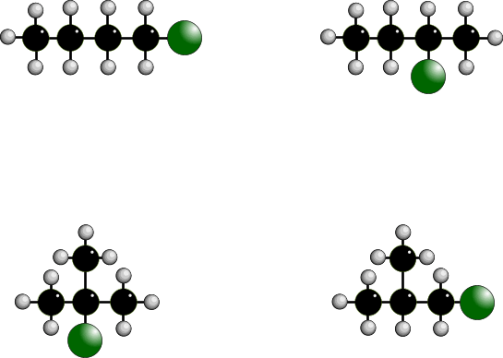
STRUCTURAL ISOMERISM IN HALOGENOALKANES
Different structures are possible due to...
Different positions for the halogen and branching of the carbon chain
1-chlorobutane
2-chlorobutane
2-chloro-2-methylpropane
1-chloro-2-methylpropane

Slide 7
PHYSICAL PROPERTIES
Boiling point Increases with molecular size due to increased van der Waals’ forces
M_{r} bp / °C
chloroethane 64.5 13
1- chloropropane 78.5 47
1-bromopropane 124 71
Boiling point also increases for “straight” chain isomers.
Greater branching = lower inter-molecular forces
bp / °C
1-bromobutane CH₃CH₂CH₂CH₂Br 101
2-bromobutane CH₃CH₂CHBrCH₃ 91
2-bromo -2-methylpropane (CH₃)₃CBr 73
Solubility Halogenoalkanes are soluble in organic solvents but insoluble in water

Slide 8


NUCLEOPHILIC SUBSTITUTION
Theory • halogens have a greater electronegativity than carbon
• electronegativity is the ability to attract the shared pair in a covalent bond
• a dipole is induced in the C-X bond and it becomes polar
• the carbon is thus open to attack by nucleophiles
• nucleophile means ‘liking positive’
the greater electronegativity of the halogen attracts the
shared pair of electrons so it becomes slightly negative;
the bond is now polar.
NUCLEOPHILES • ELECTRON PAIR DONORS
• possess at least one LONE PAIR of electrons
• don’t have to possess a negative charge
• are attracted to the slightly positive (electron deficient) carbon
• examples are OH¯, CN¯, NH₃ and H₂O (water is a poor nucleophile)
OH¯ CN¯ NH₃ H₂O

Slide 9
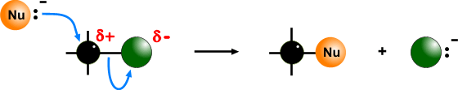
NUCLEOPHILIC SUBSTITUTION - MECHANISM
The nucleophile uses its lone pair to provide the electrons for a new bond
the halogen is displaced - carbon can only have 8 electrons in its outer shell
the result is substitution following attack by a nucleophile
the mechanism is therefore known as - NUCLEOPHILIC SUBSTITUTION
Points the nucleophile has a lone pair of electrons
the carbon-halogen bond is polar
a ‘curly arrow’ is drawn from the lone pair to the slightly positive carbon atom
a ‘curly arrow’ is used to show the movement of a pair of electrons
carbon is restricted to 8 electrons in its outer shell - a bond must be broken
the polar carbon-halogen bond breaks heterolytically (unevenly)
the second ‘curly arrow’ shows the shared pair moving onto the halogen
the halogen now has its own electron back plus that from the carbon atom
it now becomes a negatively charged halide ion
a halide ion (the leaving group) is displaced

Slide 10
NUCLEOPHILIC SUBSTITUTION - RATE OF REACTION
Basics An important reaction step is the breaking of the carbon-halogen (C-X) bond
The rate of reaction depends on the strength of the C-X bond
C-I 238 kJmol⁻¹ weakest - easiest to break
C-Br 276 kJmol⁻¹
C-Cl 338 kJmol⁻¹
C-F 484 kJmol⁻¹ strongest - hardest to break
Experiment Water is a poor nucleophile but it can slowly displace halide ions
C₂H₅Br(l) + H₂O(l) ——> C₂H₅OH(l) + H⁺ (aq) + Br¯(aq)
If aqueous silver nitrate is shaken with a halogenoalkane (they are immiscible) the displaced halide combines with a silver ion to form a precipitate of a silver
halide. The weaker the C-X bond the quicker the precipitate appears.
This form of nucleophilic substitution is known as S_{N}2; it is a bimolecular process.
An alternative method involves the initial breaking of the C-X bond to form a carbocation,
or carbonium ion, (a unimolecular process - S_{N}1 mechanism), which is then attacked by
the nucleophile. S_{N}1 is favoured for tertiary haloalkanes where there is steric hindrance
to the attack and a more stable tertiary, 3°, carbocation intermediate is formed.

Slide 11
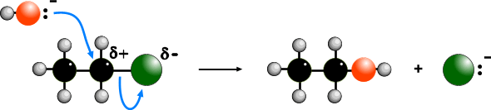
NUCLEOPHILIC SUBSTITUTION
AQUEOUS SODIUM HYDROXIDE
Reagent Aqueous* sodium (or potassium) hydroxide
Conditions Reflux in aqueous solution (SOLVENT IS IMPORTANT)
Product Alcohol
Nucleophile hydroxide ion (OH¯)
Equation e.g. C₂H₅Br(l) + NaOH(aq) ——> C₂H₅OH(l) + NaBr(aq)
Mechanism
* WARNING It is important to quote the solvent when answering questions.
Elimination takes place when ethanol is the solvent - SEE LATER
The reaction (and the one with water) is known as HYDROLYSIS

Slide 12

NUCLEOPHILIC SUBSTITUTION
AQUEOUS SODIUM HYDROXIDE
ANIMATED MECHANISM

Slide 13
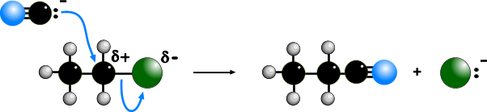
NUCLEOPHILIC SUBSTITUTION
POTASSIUM CYANIDE
Reagent Aqueous, alcoholic potassium (or sodium) cyanide
Conditions Reflux in aqueous , alcoholic solution
Product Nitrile (cyanide)
Nucleophile cyanide ion (CN¯)
Equation e.g. C₂H₅Br + KCN (aq/alc) ——> C₂H₅CN + KBr(aq)
Mechanism

Slide 14
NUCLEOPHILIC SUBSTITUTION
POTASSIUM CYANIDE
Reagent Aqueous, alcoholic potassium (or sodium) cyanide
Conditions Reflux in aqueous , alcoholic solution
Product Nitrile (cyanide)
Nucleophile cyanide ion (CN¯)
Equation e.g. C₂H₅Br + KCN (aq/alc) ——> C₂H₅CN + KBr(aq)
Mechanism
Importance extends the carbon chain by one carbon atom
the CN group can be converted to carboxylic acids or amines.
Hydrolysis C₂H₅CN + 2H₂O ———> C₂H₅COOH + NH₃
Reduction C₂H₅CN + 4[H] ———> C₂H₅CH₂NH₂

Slide 15

NUCLEOPHILIC SUBSTITUTION
POTASSIUM CYANIDE
ANIMATED MECHANISM

Slide 16
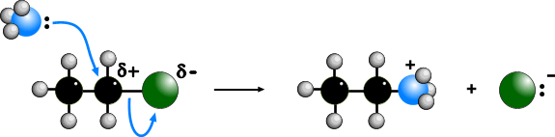
NUCLEOPHILIC SUBSTITUTION
AMMONIA
Reagent Aqueous, alcoholic ammonia (in EXCESS)
Conditions Reflux in aqueous , alcoholic solution under pressure
Product Amine
Nucleophile Ammonia (NH₃)
Equation e.g. C₂H₅Br + 2NH₃ (aq / alc) ——> C₂H₅NH₂ + NH₄Br
(i) C₂H₅Br + NH₃ (aq / alc) ——> C₂H₅NH₂ + HBr
(ii) HBr + NH₃ (aq / alc) ——> NH₄Br
Mechanism
Notes The equation shows two ammonia molecules.
The second one ensures that a salt is not formed.

Slide 17
NUCLEOPHILIC SUBSTITUTION
AMMONIA
Why excess ammonia?
The second ammonia molecule ensures the removal of HBr which would lead to the formation of a salt. A large excess ammonia ensures that further substitution doesn’t take place - see below
Problem
Amines are also nucleophiles (lone pair on N) and can attack another molecule of halogenoalkane to produce a 2° amine. This too is a nucleophile and can react further producing a 3° amine and, eventually an ionic quarternary ammonium salt.
C₂H₅NH₂ + C₂H₅Br ——> HBr + (C₂H₅)₂NH diethylamine, a 2° amine
(C₂H₅)₂NH + C₂H₅Br ——> HBr + (C₂H₅)₃N triethylamine, a 3° amine
(C₂H₅)₃N + C₂H₅Br ——> (C₂H₅)₄N⁺ Br¯ tetraethylammonium bromide
a quaternary (4°) salt

Slide 18
NUCLEOPHILIC SUBSTITUTION
WATER
Details A similar reaction to that with OH¯ takes place with water.
It is slower as water is a poor nucleophile.
Equation C₂H₅Br(l) + H₂O(l) ——> C₂H₅OH(l) + HBr(aq)

Slide 19
ELIMINATION v. SUBSTITUTION
The products of reactions between haloalkanes and OH¯ are influenced by the solvent
SOLVENT
ROLE OF OH–
MECHANISM
PRODUCT
WATER
NUCLEOPHILE
SUBSTITUTION
ALCOHOL
ALCOHOL
BASE
ELIMINATION
ALKENE
Modes of attack
Aqueous soln OH¯ attacks the slightly positive carbon bonded to the halogen.
OH¯ acts as a nucleophile
Alcoholic soln OH¯ attacks one of the hydrogen atoms on a carbon atom adjacent
the carbon bonded to the halogen.
OH¯ acts as a base (A BASE IS A PROTON ACCEPTOR)
Both reactions take place at the same time but by varying
the solvent you can influence which mechanism dominates.

Slide 20
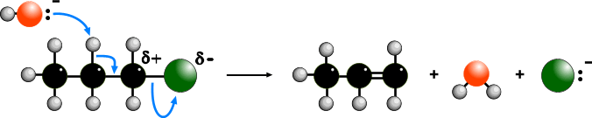
ELIMINATION
Reagent Alcoholic sodium (or potassium) hydroxide
Conditions Reflux in alcoholic solution
Product Alkene
Mechanism Elimination
Equation C₃H₇Br + NaOH(alc) ——> C₃H₆ + H₂O + NaBr
Mechanism
the OH¯ ion acts as a base and picks up a proton
the proton comes from a carbon atom next to that bonded to the halogen
the electron pair left moves to form a second bond between the carbon atoms
the halogen is displaced
overall there is ELIMINATION of HBr.
Complication With unsymmetrical halogenoalkanes, you can get mixture of products

Slide 21

ELIMINATION
ANIMATED MECHANISM

Slide 22
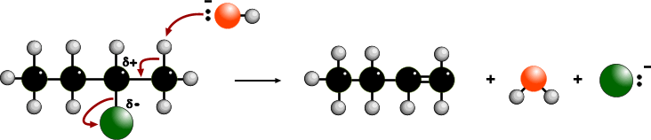
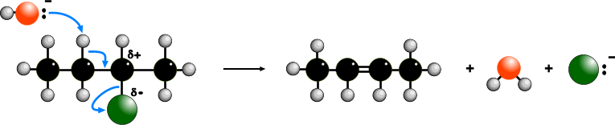
ELIMINATION
Complication
The OH¯ removes a proton from a carbon atom adjacent the C bearing the halogen. If there had been another carbon atom on the other side of the C-Halogen bond, its hydrogen(s) would also be open to attack. If the haloalkane is unsymmetrical (e.g. 2-bromobutane) a mixture of isomeric alkene products is obtained.
but-1-ene
but-2-ene
can exist as cis and trans isomers

Slide 23
USES OF HALOGENOALKANES
Synthetic The reactivity of the C-X bond means that halogenoalkanes play an
important part in synthetic organic chemistry. The halogen can be replaced by a variety of groups via nucleophilic substitution.
Polymers Many useful polymers are formed from halogeno hydrocarbons
Monomer Polymer Repeating unit
chloroethene poly(chloroethene) PVC - (CH₂ - CHCl)_{n} -
tetrafluoroethene poly(tetrafluoroethene) PTFE - (CF₂ - CF₂)_{n} -
Chlorofluorocarbons - CFC’s
dichlorofluoromethane CHFCl₂ refrigerant, aerosol propellant, blowing agent
trichlorofluoromethane CF₃Cl refrigerant, aerosol propellant, blowing agent
bromochlorodifluoromethane CBrClF₂ fire extinguishers
CCl₂FCClF₂ dry cleaning solvent, degreasing agent

Slide 24
PROBLEMS WITH CFC’s AND THE OZONE LAYER
CFC’s have been blamed for damage to the environment by thinning the ozone layer
Ozone absorbs a lot of harmful UV radiation
However it breaks down more easily in the presence of CFC's
CFC’s break up in the atmosphere to form radicals CF₂Cl₂ ——> CF₂Cl• + Cl•
Free radicals catalyse the breaking up of ozone 2O₃ ——> 3O₂
CFC’s were designed by chemists to help people
Chemists are now having to synthesise alternatives to CFC’s to protect the environment
This will allow the reversal of the ozone layer problem

Slide 25
PROBLEMS WITH CFC’s AND THE OZONE LAYER
There is a series of complex reactions but the basic process is :-
• ozone in the atmosphere breaks down naturally O₃ ——> O + O₂
• CFC's break down in UV light to form radicals CCl₂F₂ ——> Cl• + CClF₂•
• chlorine radicals then react with ozone O₃ + Cl• ——> ClO• + O₂
• chlorine radicals are regenerated ClO• + O ——> O₂ + Cl•
Overall, chlorine radicals are not used up so a small amount of CFC's can destroy
thousands of ozone molecules before they take part in a termination stage.

Slide 26
THANK YOU

