Slide 1
Hydrocarbons
BY
Asst. Prof. Lalita A. Patil
Chemistry Department,
S T Co-Op Education Society’s,
Science Senior College, Shahada
Notes:
1

Slide 2
Hydrocarbons
Aliphatic
Aromatic
Notes:
2

Slide 3
Hydrocarbons
Aliphatic
Aromatic
Alkanes
Alkenes
Alkynes
Notes:
2

Slide 4
Hydrocarbons
Alkanes are hydrocarbons in which all of the bonds are single bonds.
Aliphatic
H
H
Alkanes
H
H
C
C
H
H
Notes:
2

Slide 5
Hydrocarbons
Alkenes are hydrocarbons that contain a carbon-carbon double bond.
Aliphatic
H
H
Alkenes
C
C
H
H
Notes:
2

Slide 6
Hydrocarbons
Alkynes are hydrocarbons that contain a carbon-carbon triple bond.
Aliphatic
Alkynes
HC
CH
Notes:
2

Slide 7
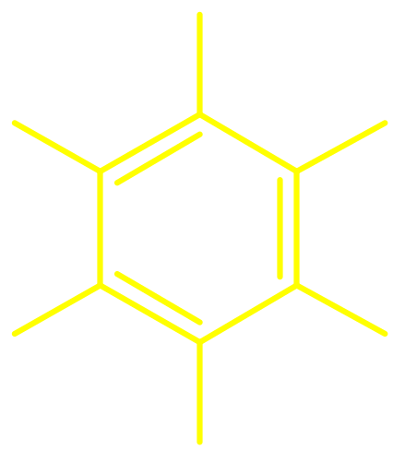
Hydrocarbons
The most common aromatic hydrocarbons are those that contain a benzene ring.
Aromatic
H
H
H
H
H
H
Notes:
2

Slide 8
2.2
Reactive Sites in Hydrocarbons
Notes:
7

Slide 9
Functional Group
a structural unit in a molecule responsible for its
characteristic behavior under a particular set of
reaction conditions
Notes:
8

Slide 10
Alkanes
R—H
R—X
functional group is a hydrogen
reaction that takes place is substitution
one of the hydrogens is replaced
by some other atom or group
Notes:
9

Slide 11
Alkanes
R—H
R—X
functional group is a hydrogen
reaction that takes place is substitution
one of the hydrogens is replaced
by some other atom or group
H
H
H
H
H
C
C
H
+ Cl₂
H
C
C
Cl
+ HCl
H
H
H
H
Notes:
9

Slide 12
Functional Groups in Hydrocarbons
alkanes RH
alkenes double bond
alkynes triple bond
arenes ArH
Notes:
10

Slide 13
2.3
The Key Functional Groups
Notes:
11

Slide 14
Families of organic compounds and
their functional groups
Alcohols ROH
Alkyl halides RX (X = F, Cl, Br, I)
Amines primary amine: RNH₂
secondary amine: R₂NH
tertiary amine: R₃N
Notes:
12

Slide 15
Families of organic compounds and
their functional groups
Epoxides
C
C
O
Ethers ROR'
Nitriles RC
Nitroalkanes RNO₂
Thiols RSH
N
Notes:
12

Slide 16
Many classes of organic compounds
contain a carbonyl group
O
O
C
C
R
Carbonyl group
Acyl group
Notes:
15

Slide 17
Many classes of organic compounds
contain a carbonyl group
O
O
C
C
R
H
Carbonyl group
Aldehyde
Notes:
15

Slide 18
Many classes of organic compounds
contain a carbonyl group
O
O
C
C
R
R'
Carbonyl group
Ketone
Notes:
15

Slide 19
Many classes of organic compounds
contain a carbonyl group
O
O
C
C
R
OH
Carbonyl group
Carboxylic acid
Notes:
15

Slide 20
Many classes of organic compounds
contain a carbonyl group
O
O
C
C
R
OR'
Carbonyl group
Ester
Notes:
15

Slide 21
Many classes of organic compounds
contain a carbonyl group
O
O
C
C
R
NH₂
Carbonyl group
Amide
Notes:
15

Slide 22
C_{n}H_{2n+2}
2.4
Introduction to Alkanes:
Methane, Ethane, and Propane
Notes:
21

Slide 23
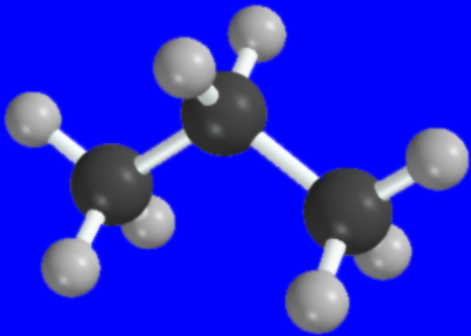
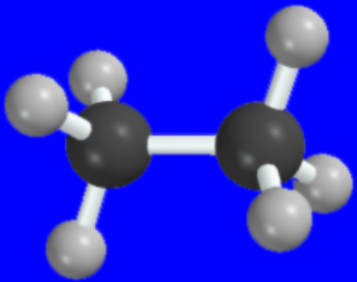
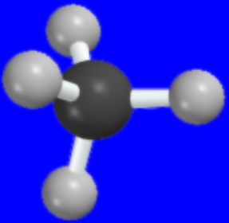
The simplest alkanes
Methane (CH₄) CH₄
Ethane (C₂H₆) CH₃CH₃
Propane (C₃H₈) CH₃CH₂CH₃
bp -160°C
bp -89°C
bp -42°C
Notes:
22

Slide 24
C₄H₁₀
2.5
Isomeric Alkanes:
The Butanes
Notes:
21

Slide 25
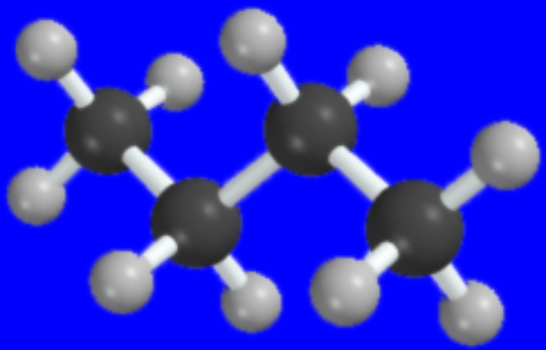
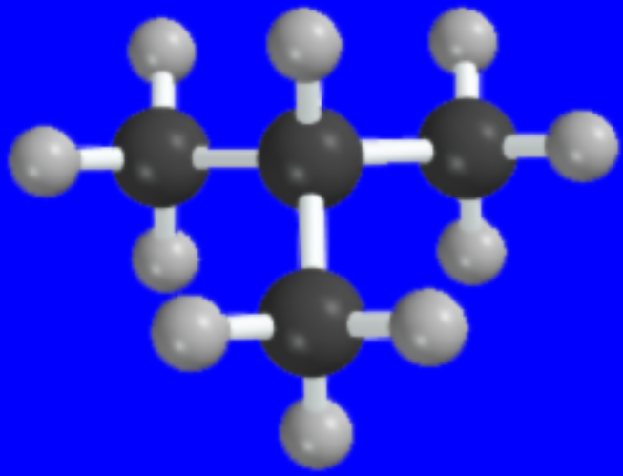
n-Butane CH₃CH₂CH₂CH₃
Isobutane (CH₃)₃CH
bp -0.4°C
bp -10.2°C
Notes:
23

Slide 26
2.6
Higher n-Alkanes
Notes:
21

Slide 27



CH₃CH₂CH₂CH₂CH₃
n-Pentane
CH₃CH₂CH₂CH₂CH₂CH₃
n-Hexane
CH₃CH₂CH₂CH₂CH₂CH₂CH₃
n-Heptane
Notes:
24

Slide 28
2.7
The C₅H₁₂ Isomers
Notes:
21

Slide 29
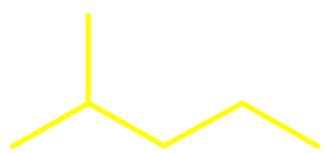

C₅H₁₂
CH₃CH₂CH₂CH₂CH₃
(CH₃)₂CHCH₂CH₃
n-Pentane
Isopentane
(CH₃)₄C
Neopentane
Notes:
25

Slide 30
How many isomers?
The number of isomeric alkanes increases as the number of carbons increase.
There is no simple way to predict how many isomers there are for a particular molecular formula.
Notes:
26

Slide 31
Table 2.3
Number of Constitutionally Isomeric Alkanes
CH₄ 1
C₂H₆ 1
C₃H₈ 1
C₄H₁₀ 2
C₅H₁₂ 3
C₆H₁₄ 5
C₇H₁₆ 9
Notes:
27

Slide 32
Table 2.3
Number of Constitutionally Isomeric Alkanes
CH₄ 1 C₈H₁₈ 18
C₂H₆ 1 C₉H₂₀ 35
C₃H₈ 1 C₁₀H₂₂ 75
C₄H₁₀ 2 C₁₅H₃₂ 4,347
C₅H₁₂ 3 C₂₀H₄₂ 366,319
C₆H₁₄ 5 C₄₀H₈₂ 62,491,178,805,831
C₇H₁₆ 9
Notes:
27

Slide 33
Thank You

