Slide 1
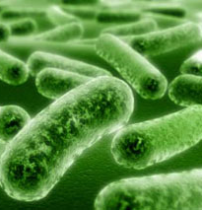
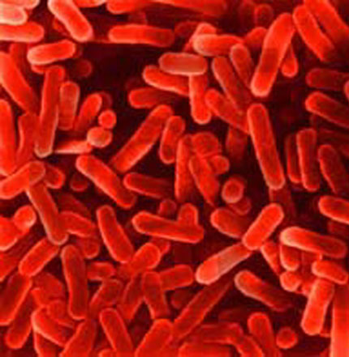
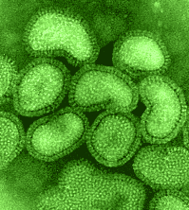
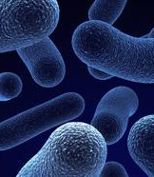
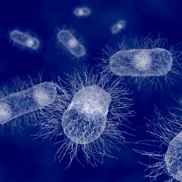
Food Preservation and Foodborne Microbial Diseases
Asst. Prof. Nagarale kalyani R.

Slide 2
Food Preservation and Microbial Growth
1 Microbial Growth and Food Spoilage
2 Food Preservation

Slide 3
Microbial Growth and Food Spoilage
Food spoilage
  Any change in appearance, smell, or taste of a food product that makes it unpalatable to the consumer
  Food may still be safe to eat, but is regarded as unacceptable
The chemical composition of a food determines its susceptibility to microbial spoilage
  Perishable (easily spoiled), including many fresh food items;
  Semiperishable, potatoes and nuts
  Nonperishable, flour and sugar

Slide 4
Microbial Growth and Food Spoilage
Susceptibility to food spoilage is based in large part on moisture content
  Perishable foods have higher moisture content than nonperishable foods
  Water activity is a measure of the availability of water for use in metabolic processes.
Fresh foods are spoiled by both bacteria and fungi
  Spoilage organisms are those that can gain access to the food and use the available nutrients
    For example, Escherichia coli frequently contaminates meat products because it is found in animals’ digestive tracts

Slide 5
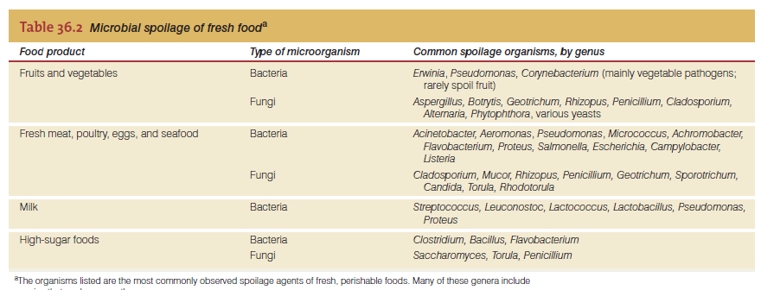

Slide 6
Microbial Growth and Food Spoilage
Growth of Microorganisms in Foods
  Microbial growth follows the normal pattern for bacterial growth
  Only during the last few population doublings is food spoilage actually observed
  The rate of growth during the exponential phase depends on the temperature, the nutrient value of the food, and the suitability of other growth conditions.

Slide 7
Food Preservation
Methods for slowing spoilage and foodborne disease
  Cold
  Pickling and acidity
  Drying and dehydration
  Heating
  Aseptic food processing
  Chemical preservation
  Irradiation

Slide 8
Food Preservation
Cold
  Slows microbial growth rate and delays spoilage
  Psychrotolerant bacteria can grow at refrigerator temperatures
  Freezing allows for longer storage, but isn’t suitable for all foods
  Freezing and subsequent thawing, however, alter the physical
  structure, taste, and appearance of many foods
    such as meats and many fruits and vegetables can be frozen

Slide 9
Food Preservation
Pickling and acidity
  pH is an important factor in microbial growth
  Most foods are neutral or acidic
  At pH <5, most spoilage organisms are inhibited
  During pickling process, acetic acid is added to a solution with sugar or salt
  decrease water availability and further inhibit microbial growth.
    Pickled foods include pickles, fish, peppers, and fruits

Slide 10
Food Preservation
Drying and dehydration
  Moisture content (water activity) is critical for microbial metabolic processes
  Sugar and salt reduce the availability of water for microbial growth (in effect, dehydrating it)
    Examples: jams, jellies, dried meats, fish
  Lyophilization (freeze-drying) is the physical removal of frozen water under vacuum
    Very expensive, but very effective
Notes:
The aw of pure water is 1.00; the molecules in pure water are loosely ordered and rearrange freely. When solute is added, the aw decreases. As water molecules reorder around the
solute, the free rearrangement of the solute-bound water molecules becomes energetically unfavorable. The microbial cells
must then compete with solute for the reduced amount of free water. In general, bacteria are poor competitors for the remaining
free water, but fungi are good competitors.

Slide 11
Food Preservation
Heating
  Used to reduce the bacterial load
  (i.e., pasteurization) of a product (milk, fruit juices, and beer) or to actually sterilize it (i.e., canning)
In theory, canning should sterilize the food product, but this requires processing at the correct temperature for the correct length of time.
  However, when properly sealed and heated, most canned food should remain stable and unspoiled indefinitely at any temperature.
  Canning isn’t always 100% effective (Figure 36.2)
    Failure results in swollen cans (DO NOT EAT!)

Slide 12
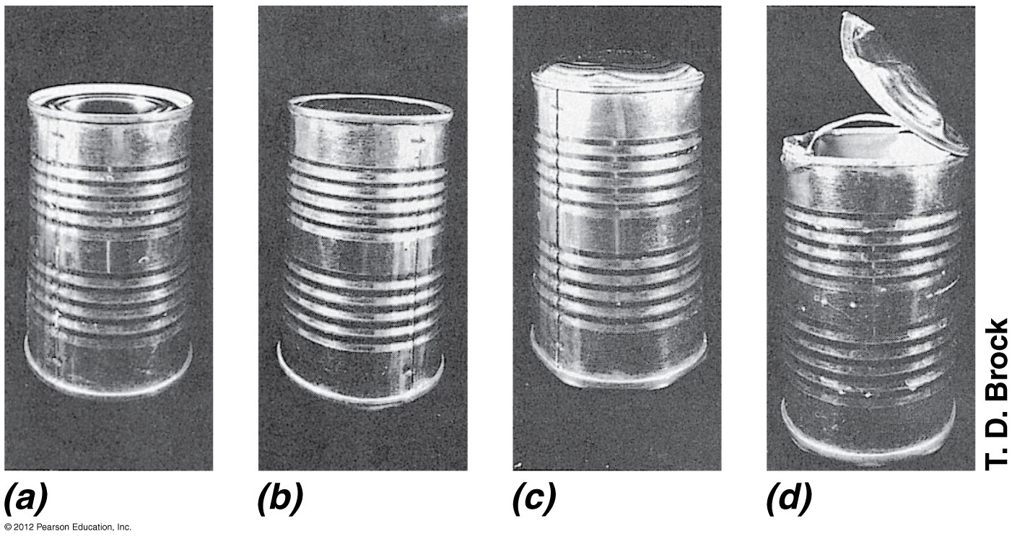
Figure 36.2
Changes in sealed tin cans as a result of microbial spoilage. (a) A normal can.
The top of the can is pulled in slightly due to the negative pressure (vacuum) inside. (b) Swelling resulting from minimal gas production. The top of the can bulges slightly. (c) Severe swelling due to extensive gas production. (d) The can shown in part c was dropped, and the gas pressure resulted in a violent explosion, tearing the lid apart.
© 2012 Pearson Education, Inc.
Notes:
Figure 36.2 Changes in sealed tin cans as a result of microbial spoilage.

Slide 13
Food Preservation
Aseptic food processing
  Several foods are now processed and packaged aseptically
  This food can be stored on shelves for months or longer
  Involves flash heating and packing in sterile containers
  Examples: juice boxes and milk substitutes

Slide 14
Food Preservation
Chemical preservation
  Over 3,000 compounds are used as food additives
  A small number of these are used to control microbial growth
    Examples: sodium propionate, sodium benzoate, nitrites
    Some, such as nitrates, are controversial because studies show they may be harmful to human health
  Significantly extends shelf life of finished foods

Slide 15
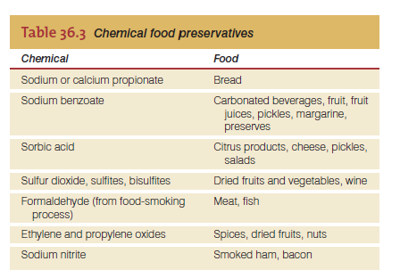

Slide 16
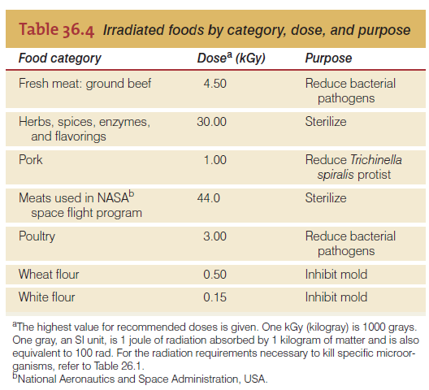
Food Preservation
Irradiation
  Food is irradiated with ionizing radiation to reduce bacterial, fungal, and insect contamination
  Uses gamma or beta radiation, or X-rays
  Irradiated foods must be labeled

Slide 17

Figure 36.4
The radura, the international symbol for radiation. Packaging of foods treated with radiation must be labeled with the radura, the international symbol for radiation, as well as the statement “treated by irradiation” or “treated with radiation.”
Notes:
Figure 36.4 The radura, the international symbol for radiation.

Slide 18
Fermented Foods and Mushrooms
Many common foods are preserved, produced, or enhanced by the actions of microbes
  Fermentation is the anaerobic catabolism of organic compounds (generally carbohydrates)
  Important bacteria in the fermented food industry are lactic acid bacteria, propionic acid bacteria, and acetic acid bacteria
  Products of fermentation include yeast bread, cheese, yogurt, buttermilk, sausage, sauerkraut, and soy sauce (Figure 36.5)

Slide 19
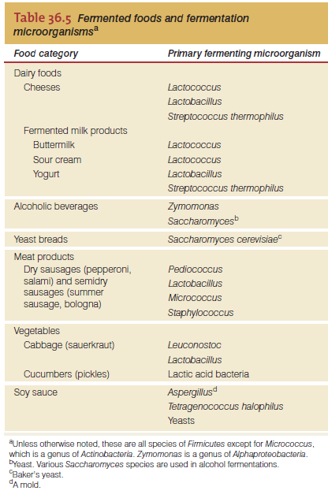

Slide 20
Fermented Foods and Mushrooms
Dairy Products
  Include cheese, yogurt, buttermilk, and sour cream
  Lactic acid bacteria are added to the milk and the fermentation proceeds for a certain time period
  Some products require a second fermentation
    The secondary fermentation catabolizes lactic acid to propionic acid, acetic acid, and CO2. The CO2 produces the large holes that characterize
    Swiss-style cheeses.

Slide 21
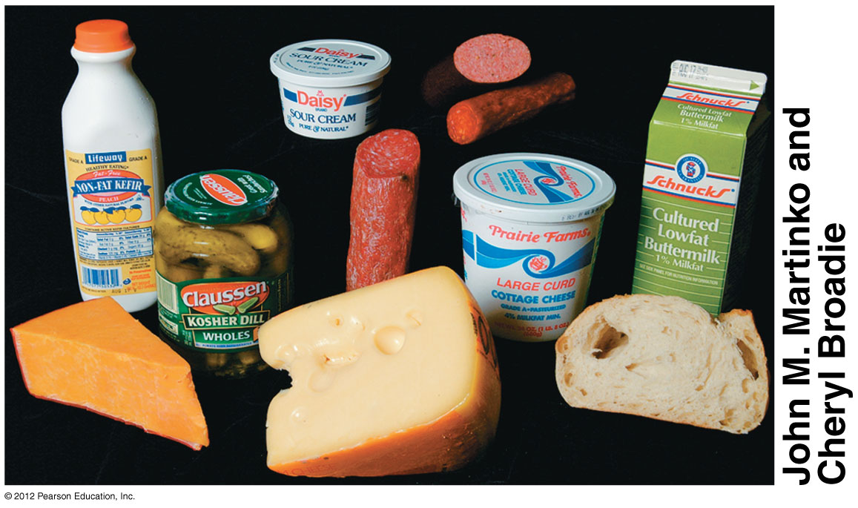
Fermented foods. Bread, sausage meats, cheeses, many dairy products, and fermented and pickled vegetables are food products that are produced or enhanced by fermentation reactions catalyzed by microorganisms.
© 2012 Pearson Education, Inc.
Notes:
Figure 36.5 Fermented foods.

