Slide 1
S.T.E.S & Co-Op Educational Society Ltd.,
Science Sr. College, Shahada
Dynamics ME
BY
Asst. Prof. Bhushan P. Nikam

Slide 2
Objective
Moment of Inertia of a body
Parallel Axis Theorem
Radius of Gyration

Slide 3
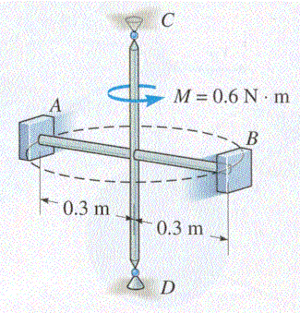
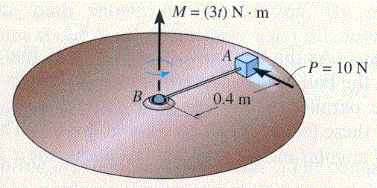
Moment and Angular Acceleration
When Μ ≠ 0, rigid body experiences angular acceleration
Relation between M and α is analogous to relation between F and a
Mass = Resistance
Moment of Inertia

Slide 4
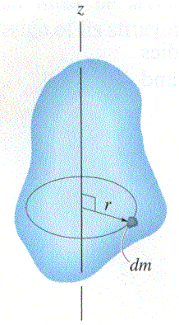
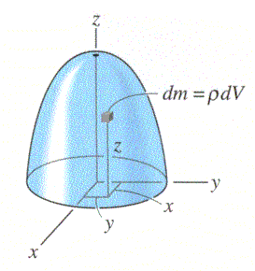
Moment of Inertia
This mass analog is called the
moment of inertia, I, of the object
  r = moment arm
  SI units are kg m²

Slide 5
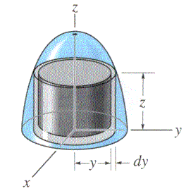
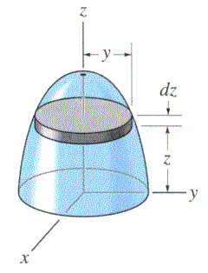
Shell Element
Disk Element

Slide 6
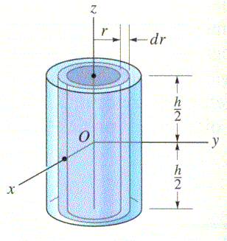
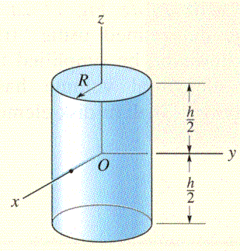
Example 17-1

Slide 7
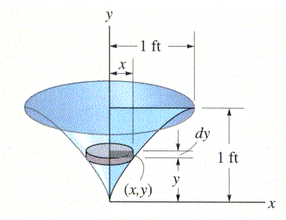
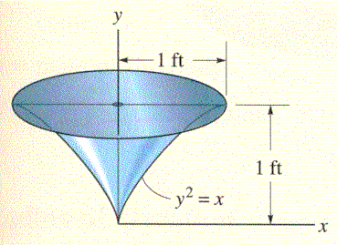
Example 17-2

Slide 8
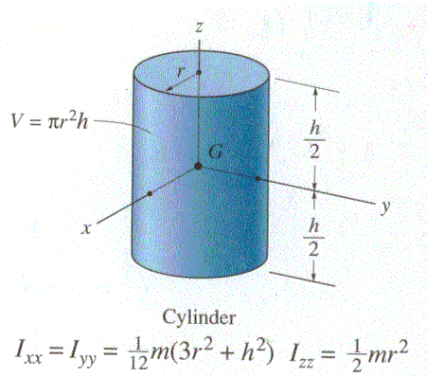

Slide 9
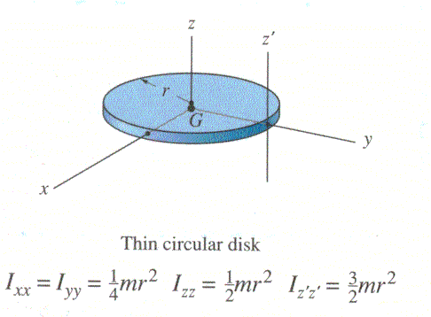
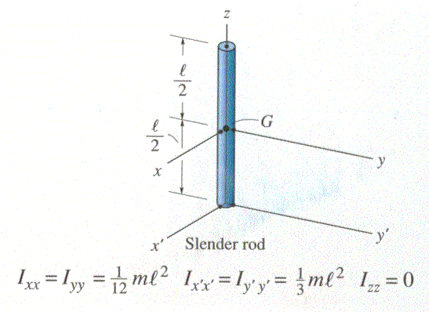

Slide 10
Moments of inertia for some common geometric solids
L
L
R₂
R
R₂
a
a
R
b
b
R
R

Slide 11
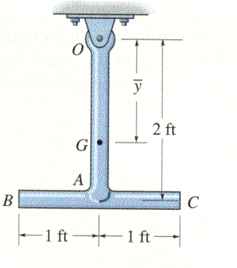
Parallel Axis Theorem
The moment of inertia about any axis parallel to and at distance d away from the axis that passes through the centre of mass is:
Where
  I_{G}= moment of inertia for mass centre G
  m = mass of the body
  d = perpendicular distance between the parallel axes.

Slide 12
Radius of Gyration
Frequently tabulated data related to moments of inertia will be presented in terms of radius of gyration.

Slide 13
Moment of inertia of a hollow cylinder
Moment of Inertia of a solid cylinder
A hollow cylinder
I = ¹/₂ mR²
=
-
M
m₂
m₁
R₁
R₂
I = ¹/₂ m₁R₁² - ¹/₂ m₂R₂² = ¹/₂ M (R₁² - R₂² )

Slide 14
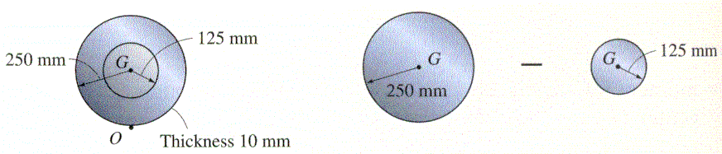
Example 17-3

Slide 16

Thank You

