Slide 1
S.T.Co-Op Education Society’s Science Senior College, Shahada
IC 555- Timers (Astable and Monostable Multivibrator)
By: Asst. Prof. Anil Jagdale

Slide 2
Index
What is a 555 timer IC?
Pin Description of the 555 Timer IC

Slide 3
What is a 555 timer IC?
555timer is an integrated circuit which contains 8 pins and the description of each pin is given in the pin description.
This timer is used in the pulse generation, oscillators and in different timer circuits.
The 555timer produces time delays in the oscillator, also in flip flop elements and the 555 timer contains three modes which are Astable, Bistable and Monostable modes.

Slide 4
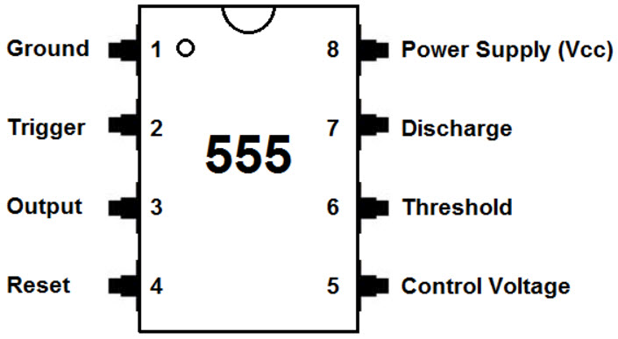
Pin Description of the 555 Timer IC
The 555 timer consists of 8 pins and these pins contain different types of functions. The following table shows the functions of a 555 timer IC and its pin diagram

Slide 5
Pin No | Pin Name | Function of the Pin
1 | Ground | This pin is connected to Ground
2 | Trigger | This pin appears like a starter pistol to start the IC. This trigger is an active low trigger. Because when the 555 timer starts if the voltage on pin 2 is below 1/3 of the main voltage. The output of the pin 3 goes higher when the 555 timer is triggered through pin 2
3 | Output | The pin 3 is an output pin and the output is digital nature. The output may be low or high. If the output is low,then the value is close to 0V. If the output is high, then the value is close to +5V. The output pin is connected to load to power the 555 timer
4 | Reset | This pin is used to restart the 555 timer and it is connected to the supply voltage.

Slide 6
Pin No | Pin Name | Function of the Pin
5 | Control Voltage | This is used to control the voltage and it is connected to the ground in most of the 555 circuits through a small capacitor of 0.1 µF. This capacitor is used to avoid the faction in the power supply voltage.
6 | Threshold | This pin is used to maintain the voltage across the capacitor which is discharged with the help of the pin 7.
7 | Discharge | This pin is a discharge pin it discharges the external capacitor and worked as a conjunction with the resistor to control the time interval.
8 | Power supply | The 555 timer gets the power supply from this pin the maximum power supply is not more than +5v.

Slide 7
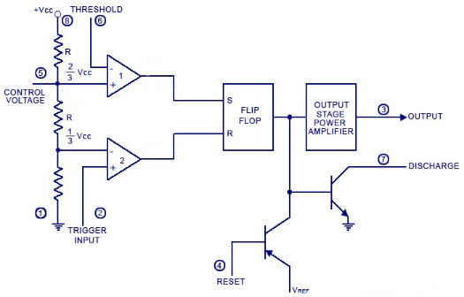
Block Diagram of 555 Timer IC

Slide 8
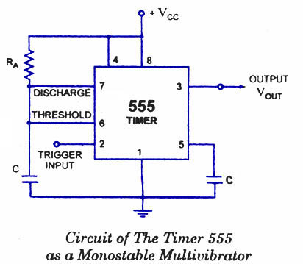
Applications of IC 555
555 Timer as Monostable Multivibrator
Description:
In the standby state, FF holds transistor Q1 ON, thus clamping the external timing capacitor C to ground. The output remains at ground potential. i.e. Low.
As the trigger passes through VCC/3, the FF is set, i.e. Q bar=0, then the transistor Q1 OFF and the short circuit across the timing capacitor C is released. As Q bar is low , output goes HIGH.

Slide 9
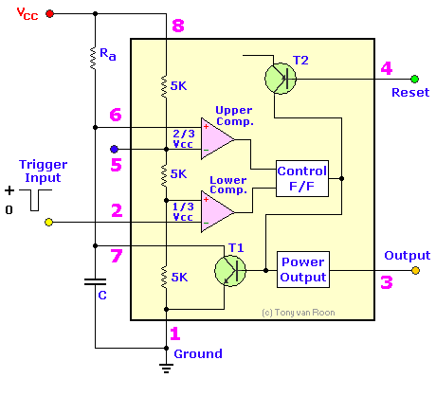
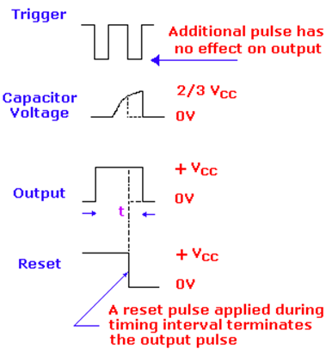
Fig (a): Timer in Monostable Operation with Functional Diagram
Fig (b): Output wave Form of Monostable

Slide 10
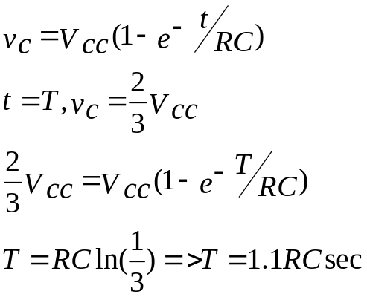
Voltage across it rises exponentially through R towards Vcc with a time constant RC.
After Time Period T, the capacitor voltage is just greater than 2Vcc/3 and the upper comparator resets the FF, i.e. R=1, S=0. This makes Q bar =1, C rapidly to ground potential.
The voltage across the capacitor as given by,
If –ve going reset pulse terminal (pin 4) is applied, then transistor Q2-> OFF, Q1-> ON & the external timing capacitor C is immediately discharged.
at

Slide 11
Applications in Monostable Mode
Missing Pulse Detector.
Linear Ramp Generator.
Frequency Divider.
Pulse Width Modulation.

Slide 12
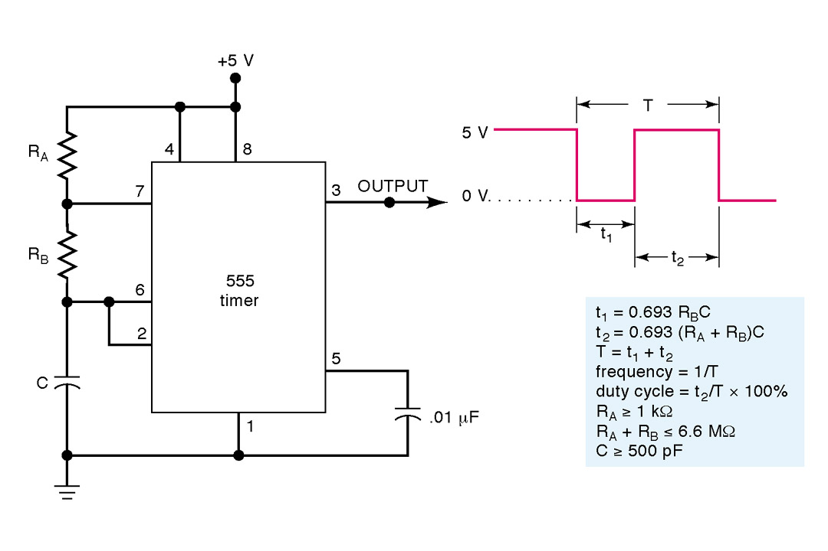
Astable Multivibrator
Fig (a): Diagram of Astable Multvibrator
1 – Ground 5 – FM Input (Tie to gnd via bypass cap)
2 – Trigger 6 – Threshold
3 – Output 7 – Discharge
4 – Reset (Set HIGH for normal operation) 8 – Voltage Supply (+5 to +15 V)

Slide 13
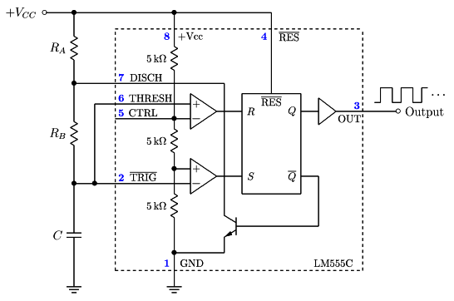
Astable Multivibrator
R1
VA
A1
A1
Vo
V1
R2
V2
A2
A2
VC
VT
R3
Q1
Fig (b): Functional Diagram of Astable Multivibrator using 555 Timer

Slide 14
Astable Multivibrator- Description
Connect external timing capacitor between trigger point (pin 2) and Ground.
Split external timing resistor R into RA & RB, and connect their junction to discharge terminal (pin 7).
Remove trigger input, monostable is converted to Astable multivibrator.
This circuit has no stable state. The circuits changes its state alternately. Hence the operation is also called free running oscillator.

Slide 15

Astable 555 Timer Block Diagram Contents
Resistive voltage divider (equal resistors) sets threshold voltages for comparators
  V₁ = V_{TH} = 2/3 V_{CC} V₂ = V_{TL} = 1/3 V_{CC}
Two Voltage Comparators
  For A1, if V₊ > V_{TH} then R =HIGH
  For A2, if V₋ < V_{TL} then S = HIGH
RS FF
  If S = HIGH, then FF is SET, = LOW, Q1 OFF, V_{OUT} = HIGH
  If R = HIGH, then FF is RESET, = HIGH, Q1 ON, V_{OUT} = LOW
Transistor Q₁ is used as a Switch

Slide 16
Operation of a 555 Astable
Assume initially that the capacitor is discharged.
  For A1, V₊ = V_{C} = 0V and for A2, V₋ = V_{C} = 0V, so R=LOW, S=HIGH, = LOW , Q1 OFF, V_{OUT} = V_{CC}
  Now as the capacitor charges through R_{A} & R_{B}, eventually V_{C} > V_{TL} so R=LOW & S=LOW.
  FF does not change state.
R_{A} R_{B}
V_{C}(t)
V_{CC}

Slide 17
Operation of a 555 Astable
Continued……
Once V_{C} ≥ V_{TH}
  R=HIGH, S=LOW, = HIGH ,Q1 ON, V_{OUT} = 0
  Capacitor is now discharging through R_{B} and Q₁ to ground.
  Meanwhile at FF, R=LOW & S=LOW since
  V_{C} < V_{TH}.
R_{B}
V_{C}(t)
Q1

Slide 18
Operation of a 555 Astable Continued…..
Once V_{C} < V_{TL}
  R=LOW, S=HIGH, = LOW , Q1 OFF, V_{OUT} = V_{CC}
  Capacitor is now charging through R_{A} & R_{B} again.
R_{A} R_{B}
V_{C}(t)
V_{CC}

Slide 19




Timing Diagram of a 555 Astable
V_{C}(t)
V_{TH}
V_{TL}
1 2 3
t
V_{OUT}(t)
T_{L}
T_{H}
t
t = 0 t = 0'

Slide 20
Applications in Astable Mode
Square Generator
FSK Generator
Pulse Position Modulator

