Slide 1
S.T.Co-Op Education Society’s Science Senior College, Shahada
Operational Amplifiers
By: Asst. Prof. Anil Jagdale

Slide 2
Index
Introduction
Background
Amplifier Introduction
Schematic of μA741
Characteristics of an Ideal Op Amp
Ideal versus Real Op-Amps
Applications

Slide 3
Background
Originally invented in early 1940s using vacuum tube technology
  Initial purpose was to execute math operations in analog electronic calculating machines
Reduction in size with invention of transistor
Most now made on integrated circuit (IC)
  Only most demanding applications use discrete components
Large number of applications, low cost, and ease of mass production make them extremely popular

Slide 4
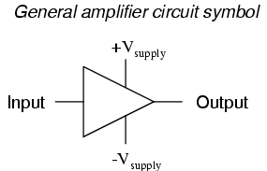
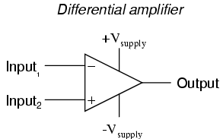
Amplifiers
Single-ended Amplifier
Differential Amplifier
  Amplifies difference between inputs

Slide 5
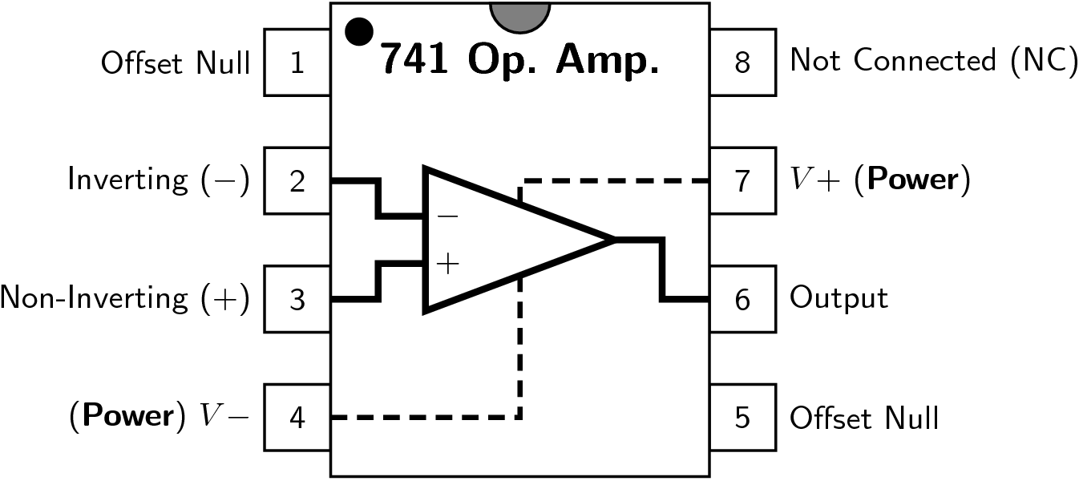
Schematic of μA741

Slide 6
OpAmp Characteristics
Infinite voltage gain
Infinite input impedance
Zero output impedance
Infinite bandwidth
Zero input offset voltage (i.e., exactly zero out if zero in)

Slide 7
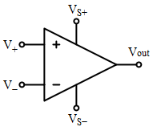
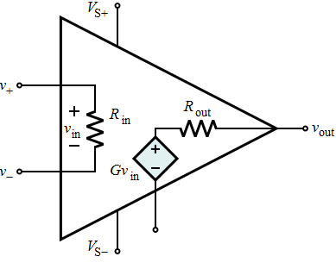
Ideal versus Real Op-Amps
Parameter | Ideal Op-Amp | Real Op-Amp
Differential Voltage Gain | ∞ | 10⁵ - 10⁹
Gain Bandwidth Product (Hz) | ∞ | 1-20 MHz
Input Resistance (R) | ∞ | 10⁶ - 10¹² Ω
Output Resistance (R) | 0 | 100 - 1000 Ω
Ideal
Real

Slide 8
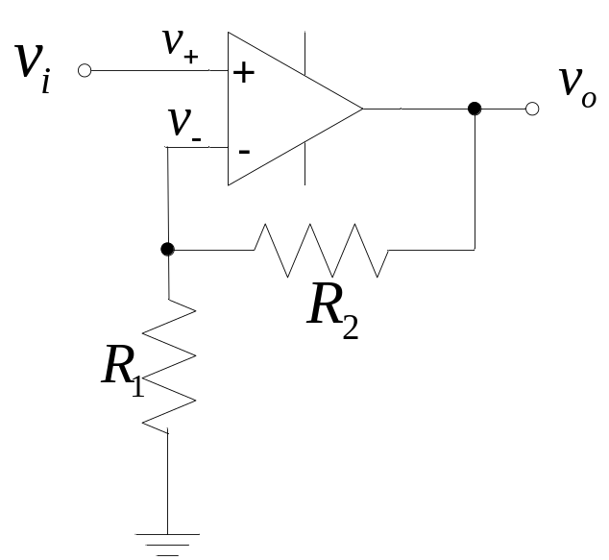
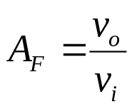
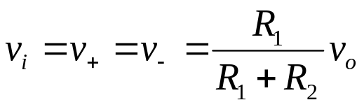
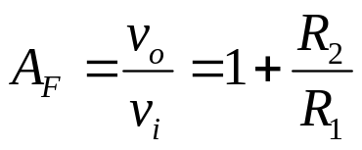
Applications
Non-inverting Amplifier
Closed-loop voltage gain

Slide 9
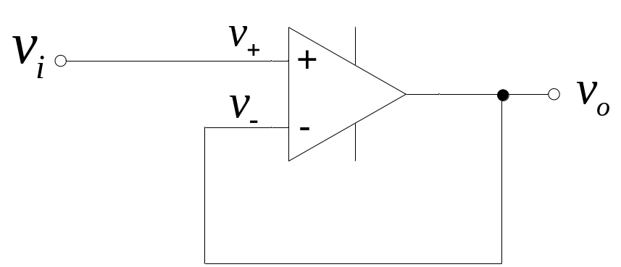

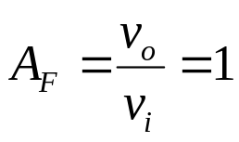
Unity-Gain Buffer
Closed-loop voltage gain
Used as a "line driver" that transforms a high input impedance (resistance) to a low output impedance.

Slide 10
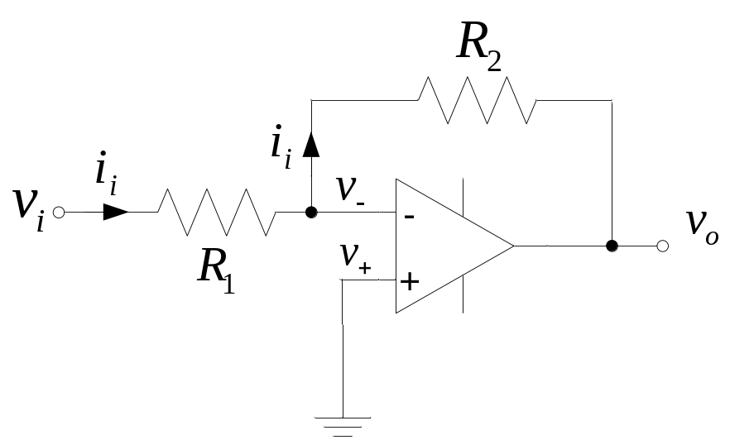

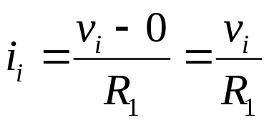
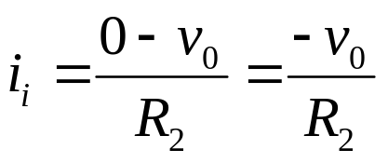
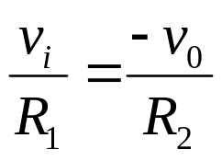
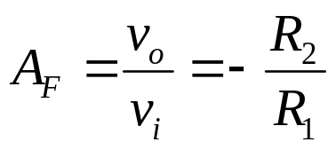
Inverting Amplifier
Current into op amp is zero

Slide 11
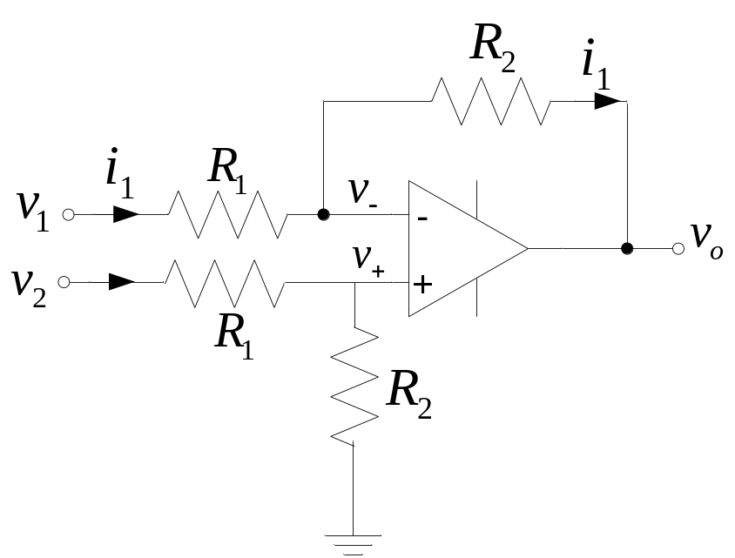

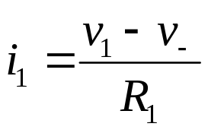
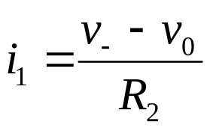
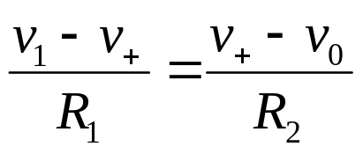
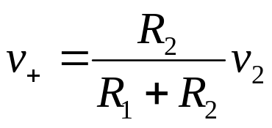
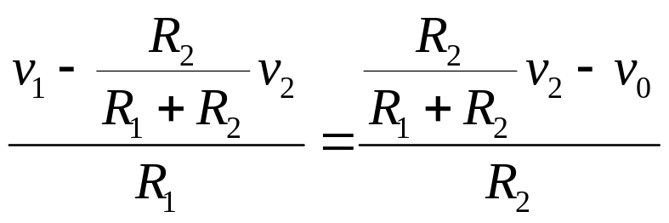
Differential Amplifier
Current into op amp is zero

Slide 12
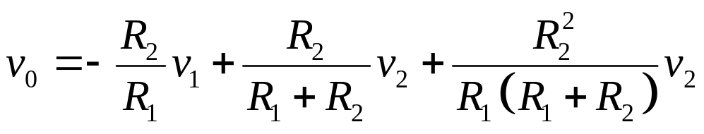
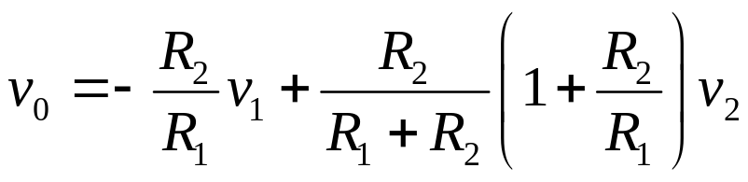
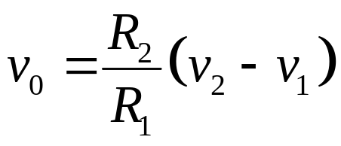

Slide 13
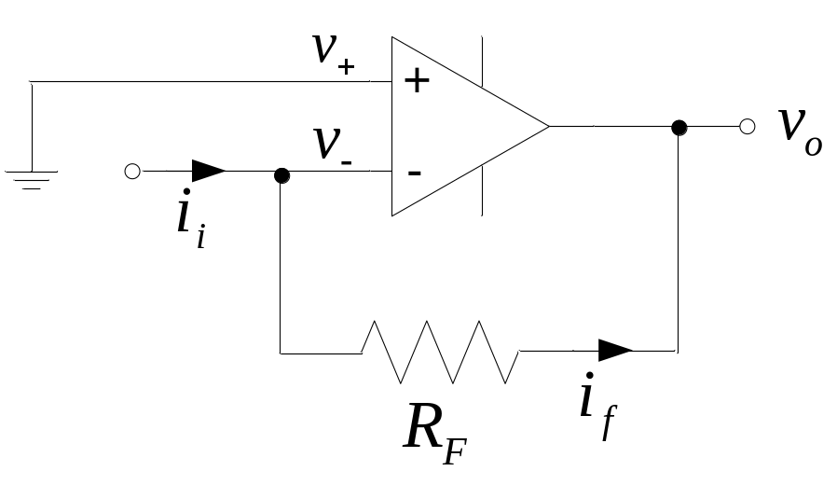
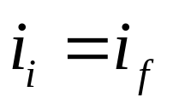
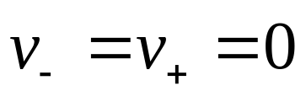
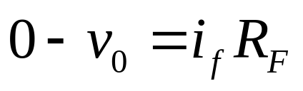
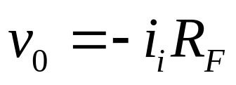
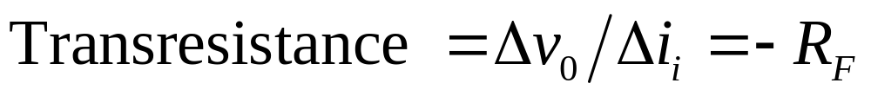
Current-to-Voltage Converter

